Slide 1

Go, change the world
RV College of
Engineering
UNIT III
RELATIONS AND FUNCTIONS
Anitha Sandeep
Asst. Professor
CSE dept
RVCE

Slide 2
Go, change the world
CONTENTS
Relations
Properties of relations, Composition of Relations, Partial Orders, Hasse Diagrams, Equivalence Relations and Partitions.
Functions
Functions-plain, One-to-one, onto functions, Sterling numbers of the second kind, Function composition and Inverse function, Growth of function.

Slide 3
Applications of relations
We can describe languages (e.g., compiler grammar, a universal Turing machine) using sets and set relations.
Graph traversal requires sets to track node visits.
Data structures are inherently set-based.
Relational databases are entirely premised on set theory in so far as table operations are concerned.
Used in studying properties of things.
Useful in game theory and logic.

Slide 4
Go, change the world
Product set: If A and B are any 2 non-empty sets then the product set of A and B are the Cartesian product or product of A and B.
A X B = {(a, b) / (a ЄA, b Є B)} A X B ≠ B X A
Example: (a) Let, A = {1, 2, 3} B = {a, b}
Then, A X B = {(1, a), (1, b), (2, a), (2, b), (3, a), (3, b)}
B X A = {(a, 1), (a, 2), (a, 3), (b, 1), (b, 2), (b, 3)}
A X B ≠ B x A

Slide 5
Go, change the world
v
(b) Let, A = {1, 2} B = {a, b} C={x, y}
B X C = {(a, x), (a, y), (b, x), (b, y)}
A X (B X C) = {(1, (a, x)), (1, (a, y)), (1, (b, x)), (1, (b, y)),
(2, (a, x)) (2, (a, y)), (2, (b, x)), (2, (b, y))}
A X B = {(1, a), (1, b), (2, a), (2, b)}
(A X B) X C = {((1, a), x), ((1, a), y), ((1, b), x), ((1, b), y),
((2, a), x), ((2, a), y), ((2, b),x),((2,b),y),}
*Remarks:
a. A X (B X C) = (A X B) X C
b. A X A = A²

Slide 6
Go, change the world
c. If R is the set of all real numbers then R x R = R², set of all points in plane.
d. (a, b) = (c, d) if a = c and b = d

Slide 7
A relation between two variables x and y is a set of ordered pairs
An ordered pair consists of an x and y-coordinate
A relation may be viewed as ordered pairs, mapping design, table, equation, or written in sentences
x-values are input, independent variable, domain.
y-values are output, dependent variable, range
What is the domain?
{0, 1, 2, 3, 4, 5}
What is the range?
{-5, -4, -3, -2, -1, 0}
R=

Slide 8
Go, change the world
v
Relations: Let A and B be any two non-empty sets. A binary relation R from a set A to the set B is a subset of A x B.
If (a, b) Є R then we write a R b, otherwise we write a R b (i.e.. a not related to b).
# of relations = 2^ n²
Example:
1.
Let S be a set of students.
Let C be a set of courses.
Let R = { (s, c) | student s is taking course c}.
Many students may take the same course.
A single student may take many courses.
2. A={1, 2, 3, 4, 5}, Let R be a relation on A defined as a R b if a<b.
Then R = {(1, 2), (1, 3), (1,4), (1, 5) (2, 3), (2, 4), (2, 5), (3, 4), (3, 5), (4, 5)}
R⊆ A X A.
If R is a relation from A to B, then
Domain of R: Dom (R) = {1, 2, 3, 4} ⊆A
Range of R: Ran (R) = {2, 3, 4, 5} ⊆B
Dom (R) = {x ЄA / x R y for some x Є A}
Ran (R) = {y Є B / x R y for some y Є B}

Slide 9
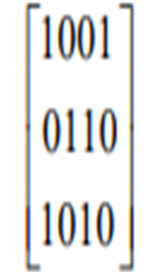
Go, change the world
Matrix representation of a relation / Relation Matrix: Let A = {a₁, a₂, a_{3…..} a_{m}} and B = {b₁, b₂,b_{3…..} b_{n}} be any two finite sets.
Let R be relation from A to B then the matrix of the relation R is defined as the m x n matrix,
M_{R}= [M_{ij}]
Where M_{ij} = 1, if (a_{i}, b_{j}) Є R
= 0, if (a_{i}, b_{j}) ∉ R
(a) Let, A={1,2,3} and B={x,4},R={(1,x),(1,4),(2,4),(3,x)}
1 1
M_{R}= 0 1
1 0
(b)Define set,
A = {a₁, a₂, a₃} and B = {b₁, b₂, b₃, b₄}
R = {(a_{1,} b₁) (a_{1,} b₄) (a₂, b₂) (a₂, b₃) (a₃, b₁) (a₃, b₃)}
Then its matrix representation is as below:

Slide 10
Go, change the world
Digraph of a relation: Let A be a finite set and R be a relation on A. Then R can be represented pictorially as follows,
Draw a small circle for each element of A and label the circles with the corresponding element of A. These circles are called "Vertices".
Draw an arrow from a_{i} to a_{j} if a_{i} R a_{j}. These arrows are called "edges".
The resulting picture representing the relation R is called the "directed graph of R" or "digraph of R".
Example:
a) Let, A be equal to the set A = {1, 2, 3, 4}
R = {(1, 1), (1, 3), (2, 1), (2, 3), (3, 2), (4, 3)}

Slide 11
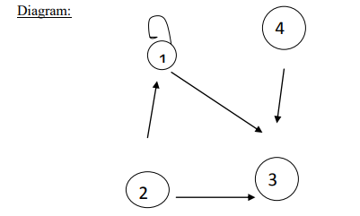
Go, change the world
The "indegree" of a ЄA is the number of elements b Є A such that b R a. The "outdegree" of a Є A is the number of elements b Є A such that a R b
Elements | Indegree | Outdegree
1 | 2 | 2
2 | 1 | 2
3 | 3 | 1
4 | 0 | 1

Slide 12

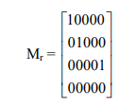
RV College of
Engineering
Go, change the world
(b) If A = {1, 2, 3, 4} and B = {1, 4, 6, 8, 9} and R: A → B defined by
a R b if b = a². Find the domain, Range, and M_{R}
A = {1, 2, 3, 4} B = {1, 4, 6, 8, 9}
R = {(x, y)/x A, y B and y = X²} R = {(1, 1), (2, 4), (3, 9)}
Domain: Dom (R) = {1, 2, 3}
Range: Ran (R) = {1, 4, 9}

Slide 13
RV College of
Engineering
Go, change the world
Properties of a relation:
1. Reflexive: A relation R on a set A is called reflexive if (a, a)∈R for every element a∈A.
Or
Let R be a relation on a set A.
The "R is reflexive" if (a, a) Є R V a ЄA or a R a, V a Є A.
# reflexive of relations = 2^ (n² - n)
Example: A = {1, 2, 3}
R = {(1, 1), (2, 2) (1, 2), (3, 2) (3, 3)}Therefore, R is reflexive.
A relation R on a set A is "not-reflexive" if ’a‘ is not relation to ‘a‘ for some a ЄA or (a,a) ∉R for some a Є A
A = {1, 2, 3}
R = {(1, 1), (2, 1), (3, 2), (3, 3)} => (2, 2) ∉R
Therefore, R is not-reflexive.
EX: Are the following relations on {1, 2, 3, 4} reflexive?
1. R = {(1, 1), (1, 2), (2, 3), (3, 3), (4, 4)} Ans: No
2. R = {(1, 1), (2, 2), (2, 3), (3, 3), (4, 4)} Ans: Yes
3. R = {(1, 1), (2, 2), (3, 3)} Ans: No

Slide 14
Go, change the world
Properties of a relation:
Irreflexive: A relation R on a set A is irreflexive if (a , a) ∉R, V a Є A.
Example: R = {(1, 2) (2, 1) (3, 2) (3, 1)}
(1, 1), (2, 2) (3, 3) ∉ R hence R is irreflexive.
A relation R on a set A is ―not irreflexive if 'a' is related to 'a' for some a Є A.
# irreflexive of relations = 2^ (n² - n)
Example:
R= {(1, 1) (1, 2) (2, 1) (3, 2) (3, 1)} on set A={1,2,3}
(1, 1) Є R hence R is ―not irreflexive
R is not reflexive also, since (2,2) and (3,3) ∉ R.
So, R is neither reflexive, nor irreflexive

Slide 15
Go, change the world
Symmetric Relation:A relation R on a set A is called symmetric if (b, a)∈R whenever (a, b)∈R for all a, b∈A. .
Example: Let A = {1, 2, 3} and R = {(1, 1) (1, 2) (2, 1) (3, 2) (2, 3)}
Therefore, R is symmetric.
A relation R on a set A is said to be "not symmetric" if a R b and b R a for some a, b Є A.
Example: A = {1, 2, 3} and R = {(1, 2) (3, 2) (1, 3) (2, 1) (2, 3)}
Therefore, R is not symmetric.
# of symmetric relations = 2^{n} x 2 ^((n²-n)/2) = 2^ ((n² + n)/2)
Asymmetric: A relation R on a set A is called asymmetric if (a, b)∈R implies that (b, a)∉R for all a, b∈A.
R = {(1, 2), (1, 3) (3, 2)}
Therefore, R is asymmetric.
A relation R on a set A is said to be "not Asymmetric" if a R b and b R a for some a, b ЄA R = {(1, 1) (1, 2) (1, 3) (3, 2)}
R is not symmetric.
# of asymmetric relations = 3 ^((n²-n)/2)

Slide 16
Go, change the world
Anti – symmetric: Let R be a relation on a set A, then R is anti symmetric if whenever a R b and b R a then a = b (for some a, b Є A)
# of antisymmetric relations = 2^{n} x 3 ^((n²-n)/2)
Example: Let, A = {1, 2, 3} and R = {(1, 1), (1, 2), (3, 2)}
R is anti-symmetric Є 1R1 and 1 = 1.
Example:
R = {(1, 2) (2, 1)}
1R2, 2R1 but 2 = 1 hence R is not anti symmetric.
Transitive Property: Let R be a relation on a set A, then R is transitive if whenever a R b and b R c, then a R c V a, b, c Є ¸ A.
Example: Let, A = {1, 2, 3} and R = {(1, 1), (1, 3), (2, 3), (3, 1) (2, 1), (3, 3)} (all should satisfy)

Slide 17
Go, change the world
Problems:
Let A, B are two sets with |B| = 3. If there are 4096 relations from A to B, what is |A|?
Ans: |A|=4
2. A={1,2,3} B={2,4,5} Then find
|AxB|
No of relations from A to B
No of relations on A
No of relations from A to B that contain (1,2) and (1,5) Ans: 2⁷
No of relations from A to B that contain 5 ordered pairs Ans: 9C5
No of relations from A to B that contain atleast 7 elements Ans: 9C7+9C8+9C9
No of relations from A to B that contain either (1,2) or (1,5) Ans: 2⁸
No of relations from A to B that contain (1,2) or (1,5) Ans: 2⁸ + 2⁸ – 2⁷ =2⁹ – 2⁷ = 3x2⁷

Slide 18
Go, change the world
Problems:
A={1,2,3} B={2,4,5} Then find
R₁ on A={(x, y): x<y} R₁ = {(1,2),(1,3),(2,3)}
R₂ on A ={(x, y): x ≤y} R₂ = {(1,1),(1,2),(1,3),(2,2),(2,3),(3,3)}
R₃ on A ={(x, y): x ≥y} R₃ = {(1,1),(2,1),(2,2),(3,1),(3,2),(3,3)}
Write properties of each relations R₁,R₂,R₃
Ans: R₁ – Not reflexive, Irreflexive, not symmetric, Asymmetric, transitive
…………..

Slide 19
Go, change the world
Problems:
4. aRb when ab ≥ 0 over Z
Write properties of relation R
Ans:
For all integers we have xx ≥ 0 ∴ R is reflexive.
If (x, y) Є R ⇒ xy ≥ 0 then yx ≥ 0 ⇒ (y, x) Є R
∴ R is symmetric.
But (3,0), (0,-7) Є R But (3,-7) ∉ R
∴ R is not transitive.
If (x, y) Є R and (y, x) Є R ⇏ x=y
Ex: (3,0), (0,3) Є R ⇏ 3=0
∴ R is not anti symmetric.

Slide 20
Go, change the world
Problems:
5. Let U be set. R is a relation on P(U) defined by (A, B) Є R if A ⊆ B for A, B Є U
Write properties of relation R
Ans:
For any A Є U, (A,A) Є R since A ⊆ A
∴ R is reflexive.
If (A, B) Є R ⇒ A ⊆ B but B ⊄ A . (B,A) ∉ R
∴ R is not symmetric.
If (A, B) Є R ⇒ A ⊆ B and If (B, C) Є R ⇒ B ⊆ C Then A ⊆ C ∴ (A,C) Є R
∴ R is transitive.
If (A, B) Є R ⇒ A ⊆ B and (B, A) Є R ⇒ B⊆ A then A=B
∴ R is anti symmetric.

Slide 21
Go, change the world
Problems:
6. R is a relation on Z⁺ defined by aRb if a exactly divides b.
Write properties of relation R
Ans:
For all positive integers we have a exactly divides a. ie a|a So,(a, a) Є R
∴ R is reflexive.
If (a, b) Є R ⇒ a|b then b∤ a ⇒ (b, a) ∉ R
∴ R is not symmetric.
If (a, b) Є R ⇒ a|b and (b,c) Є R ⇒ b|c. Then a|c ∴ (a, c) Є R
∴ R is transitive.
If (a, b) Є R ⇒ a|b and (b, a) ⇒ R b|a then a=b
∴ R is anti symmetric.

Slide 22
Go, change the world
Problems:
7. Give an example of a relation on a set that is
both symmetric and antisymmetric.
neither symmetric nor antisymmetric.
Ans:
both symmetric and antisymmetric.
If a relation is both symmetric and antisymmetric then it contains elements of form (a, a).
So if A={1,2,3} and R is a relation on A containing {(1,1),(2,2)} then it is both symmetric and antisymmetric.
b) neither symmetric nor antisymmetric.
If a relation is not symmetric , means (a, b) Є R but (b, a) ∉ R
and not antisymmetric, means (a, b) Є R and (b, a) Є R but a ≠ b.
So if A={1,2,3} and R is a relation on A containing {(1,2),(2,3)(3,2)} then it is neither symmetric nor antisymmetric.

Slide 23
Go, change the world
8. A = {1, 2, 3, 4}. Identify the properties of relations which is defined on set A.
- State whether relation is reflexive, irreflexive, symmetric, asymmetric, antisymmetric, transitive
R1 = {(1, 1),(2, 2),(3, 3),(2, 1),(4, 3),(4, 1),(3, 2)}
R2 = A × A,
R3 = φ,
R4 = {(1, 1),(2, 2),(3, 3),(4, 4)}
R5 = {(1, 1),(2, 2),(3, 3),(4, 4),(1, 2),(2, 1),(4, 3),(3, 4)}
Ans:
R1 is anti symmetric
R2 is reflexive, symmetric and transitive
R3 is irreflexive, symmetric, asymmetric, antisymmetric, transitive
R4 is reflexive, symmetric, antisymmetric, transitive
R5 is reflexive, symmetric, transitive

Slide 24
Exercises on relations
Go, change the world
9. Is the following relations on {1, 2, 3, 4} symmetric, anti symmetric, or asymmetric?
R1 ={(1, 1), (1, 2), (2, 1), (3, 3), (4, 4)}
R2 = {(1,1)}
R3 = {(1, 3), (3, 2), (2, 1)}
R4 = {(4, 4), (3, 3), (1, 4)}
Ans:
R1 is symmetric
R2 is symmetric and anti symmetric
R3 is asymmetric and antisymmetric
R4 is antisymmetric

Slide 25
Go, change the world
10. A = {1, 2, 3, 4}. Identify the properties of relations which is defined on set A.
- State whether relation is reflexive, irreflexive, symmetric, asymmetric, antisymmetric, transitive
R1 = {(1, 1),(2, 2),(3, 3),(2, 1),(4, 3),(4, 1),(3, 2)}
R2 = A × A,
R3 = φ,
R4 = {(1, 1),(2, 2),(3, 3),(4, 4)}
R5 = {(1, 1),(2, 2),(3, 3),(4, 4),(1, 2),(2, 1),(4, 3),(3, 4)}
Ans:
R1 is anti symmetric
R2 is reflexive, symmetric and transitive
R3 is irreflexive, symmetric, asymmetric, anti symmetric, transitive
R4 is reflexive, symmetric, anti symmetric, transitive
R5 is reflexive, symmetric, transitive

Slide 26
Go, change the world
More on Relations:
https://drive.google.com/file/d/1uJshiSJy_Ed_CxqIxcyUwGYp8wcfrWwc/view?usp=sharing

Slide 27
Go, change the world
Exercise Problems:
Determine whether the relation R on the set of all real numbers is reflexive, symmetric, antisymmetric, and/or transitive, where (x, y) ∈ R if and only if a) x + y = 0 b) x = ± y c) x - y is a rational number d) x = 2y e) xy ≥ 0 f) xy = 0 g) x = 1 h) x = 1 or y = 1
Ans:
(a) Symmetric (b) Reflexive, Symmetric and Transitive (c) Reflexive, Symmetric and Transitive (d) Antisymmetric (e) Reflexive and Symmetric (f) Symmetric (g) Antisymmetric and transitive (h) Symmetric

Slide 28
Go, change the world
Exercise Problems:
2. Determine whether the relation R on the set of all people is reflexive, symmetric, antisymmetric, and/or transitive, where (a, b) ∈ R if and only if
a is taller than b.
a and b were born on the same day.
a has the same first name as b.
a and b have a common grandparent.
Ans:
(a) Antisymmetric and Transitive (b) Reflexive, Symmetric and Transitive (c) Reflexive, Symmetric and Transitive (d) Reflexive and Symmetric
3

Slide 29
Go, change the world
Exercise Problems:
3. . For each of these relations on the set {1, 2, 3, 4), decide whether it is reflexive, whether it is symmetric, whether it is antisymmetric, and whether it is transitive.
{(2, 2), (2, 3), (2, 4), (3, 2), (3, 3), (3, 4)}
{(1, 1), (1, 2), (2, 1), (2, 2), (3, 3), (4, 4))
{(2, 4), (4, 2)
{(1, 2), (2, 3), (3, 4)}
{(1, 1), (2, 2), (3, 3), (4, 4)}
{(1, 3), (1, 4), (2, 3), (2, 4), (3, 1), (3, 4)}
Ans:
(a) Transitive (b) Reflexive, Symmetric and Transitive (c) Symmetric (d) Antisymmetric (e) Reflexive, Symmetric, Antisymmetric and Transitive (f) None

Slide 30
Counting on relations
Go, change the world
Example: How many different reflexive relations can be defined on a set A containing n elements?
Solution: Relations on R are subsets of A×A, which contains n² elements.
Therefore, different relations on A can be generated by choosing different subsets out of these n² elements, so there are 2^{n2} relations.
A reflexive relation, however, must contain the n elements (a, a) for every a∈A.
Consequently, we can only choose among n² – n = n(n – 1) elements to generate reflexive relations, so there are 2^{n(n – 1)} of them.

Slide 31
Counting on relations
Go, change the world
Let A be a set on which relation is defined, such that |A| = n
Then
# of relations = 2^ n²
2. # reflexive of relations = 2^ (n² - n)
3. # irreflexive of relations = 2^ (n² - n)
4. # relations that are neither reflexive, nor irreflexive
= (2^{n}-1-1)x 2^ (n² - n) = 2^{n-1}x 2^ (n² - n)
5. # of symmetric relations = 2^{n} x 2 ^((n²-n)/2) = 2^ ((n² + n)/2)
6. # of asymmetric relations = 3 ^((n2-n)/2)
7. # of anti symmetric relations = 2^{n} x 3 ^((n²-n)/2)
8. # of relations which are both symmetric and asymmetric = 1
9. # of relations which are both reflexive and antisymmetric = 3 ^((n ²−n)/2)

Slide 32
Go, change the world
Equivalence relation: A Relation R is said to be an equivalence relation if it is,
Reflexive
Symmetric and
Transitive.
Example:
1. A = {1, 2, 3}
R = A x A = {(1, 1)(1, 2)(1, 3)(2, 1)(2, 2)(2, 3)(3, 1)(3, 2)(3, 3)}
It is reflexive, symmetric and transitive and hence R is an equivalence Relation.
2 Prove that n ∈ Z⁺ , xRy when x-y is a multiple of n is an equivalence relation.
Proof:
3. For any finite set A, AxA is the largest equivalence relation and if A={a₁,a₂,a₃…..a_{n}}, then R={(a_{i} ,a_{i}) | 1≤i≤n} is the smallest equivalence relation on A.

Slide 33
Go, change the world
Equivalence relation: A Relation R is said to be an equivalence relation if it is,
Reflexive
Symmetric and
Transitive.
Example:
1. A = {1, 2, 3}
R = A x A = {(1, 1)(1, 2)(1, 3)(2, 1)(2, 2)(2, 3)(3, 1)(3, 2)(3, 3)}
It is reflexive, symmetric and transitive and hence R is an equivalence Relation.
2 Prove that n ∈ Z⁺ , xRy when x-y is a multiple of n is an equivalence relation.
Proof: x-x=0 is a multiple of n. So R is reflexive.
if (x-y) is divisible by n then y-x= –(x-y) is also divisible by n. So R is symmetric.
if (x-y) is divisible by n and (y-z) is divisible by n, then (x-z) is also divisible by n. So R is transitive.
Since R is reflexive, symmetric and transitive, R is an equivalence relation.
3. For any finite set A, AxA is the largest equivalence relation and if A={a₁,a₂,a₃…..a_{n}}, then R={(a_{i} ,a_{i}) | 1≤i≤n} is the smallest equivalence relation on A.

Slide 34
Go, change the world
Congruence modulo n:
Defn: Let n be a +ve integer. For integers a, b, we say a is congruent to b modulo n and is written as
a ≡ b mod n, when a-b is divisible by n (or n divides (a-b))
NOTE: a ≡ b mod n is equivalent to a) a-b = kn for some integer k
b) a=kn+b for some integer k
Example:
4 Congruence module n is an equivalence relation R on Z.
Proof:
a) x-x=0 , and 0 is divisible n ⇒(x, x) ∈ R. So R is reflexive.
b) if (x, y) ∈ R and ⇒ x-y= kn then y-x=–(x-y) = -kn ⇒ (y, x) ∈ R. So R is symmetric.
c) if (x, y) ∈ R and if (y, z) ∈ R ⇒ x= k₁n + y and y=k₂n + z and x = k₁n+k₂n+z = (k₁+k₂)n+z
⇒ (x, z) ∈ R. So R is transitive.
Since R is reflexive, symmetric and transitive, R is an equivalence relation.

Slide 35
Go, change the world
Partial order relation: A Relation R is said to be a partial order relation if it is,
Reflexive
Anti-Symmetric and
Transitive.
Example:“≤” on R, “⊆” on the set of subsets of (say) Z, and the “divides” relation on N^{+.}
Prove that “≤” on R on Z is a partial order relation.
Proof: R: {(a, b) | a ≤ b }
Since a ≤ a ⇒ (a, a) ∈ R . ∴ R is reflexive
If a ≤ b then b >a so if (a, b) ∈ R then (b, a) ∉ R. ∴ R is antisymmetric.
If a ≤ b and b ≤ c then a ≤ c ⇒ if (a, b) and (b, c) ∈ R then (a, c) ∈ R. ∴ R is transitive.
Since R is reflexive, antisymmetric and transitive, R is a partial order relation.
2. Prove that “divides” on R on N+ is a partial order relation
Since a | a ⇒ (a, a) ∈ R . ∴ R is reflexive
If a | b then b ∤ a so if (a, b) ∈ R then (b, a) ∉ R. ∴ R is antisymmetric.
If a | b and b | c then a | c ⇒ if (a, b) and (b, c) ∈ R then (a, c) ∈ R. ∴ R is transitive.
Since R is reflexive, antisymmetric and transitive, R is a partial order relation.

Slide 36
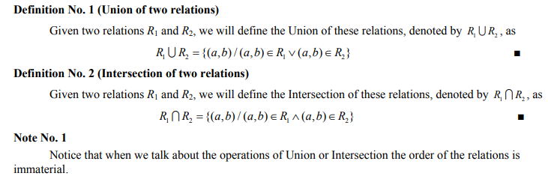
Go, change the world
Operation on relations:

Slide 37
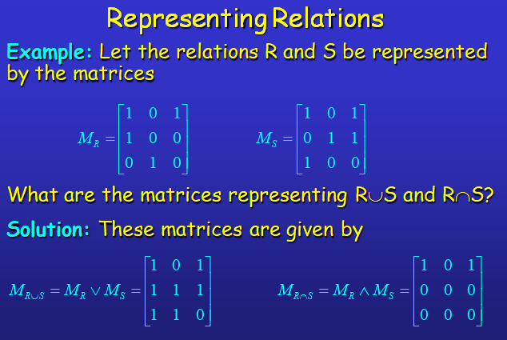
Go, change the world

Slide 38
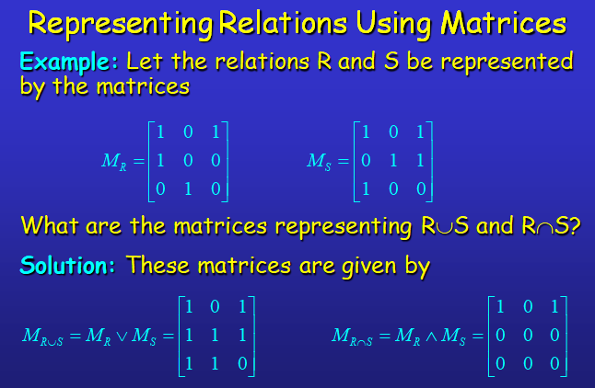
Go, change the world

Slide 39
Go, change the world
Example: Find the matrix representing R², where the matrix representing R is given by
Solution: The matrix for R² is given by

Slide 40
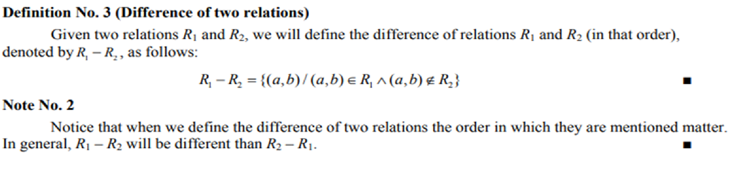
Go, change the world

Slide 41
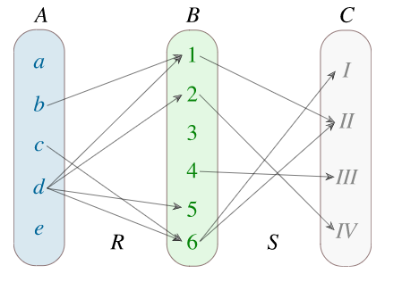
Composition of Relations
Go, change the world
Let A,B and C be three sets. Suppose that R is a relation from A to B, and S is a relation from B to C.
The composition of R and S, denoted by R∘S, is a binary relation from A to C, if and only if there is
b∈B such that aRb and bSc. Formally the composition R∘S can be written as
R∘S = {(a,c) ∣ ∃b ∈ B : aRb ∧ bSc},where a∈A and c∈C.
The composition of binary relations is associative, but not commutative.
If a relation R is defined on a set A, it can always be composed with itself. So, we may have
R∘R=R²,
R∘R∘R=R³,
R∘R∘…∘R……^{n}=R^{n}.

Slide 42
Go, change the world
1. Let D and S be relations on A = {1, 2, 3, 4}.
D = {(a, b) | b = 5 - a} “b equals (5 – a)”
S = {(a, b) | a < b} “a is smaller than b”
D = {(1, 4), (2, 3), (3, 2), (4, 1)}
S = {(1, 2), (1, 3), (1, 4), (2, 3), (2, 4), (3, 4)}
D ∘ S = {
(2, 4),
(3, 3),
(3, 4),
(4, 2),
(4, 3),
(4, 4)}
D maps an element a to the element (5 – a), and afterwards S maps (5 – a) to all elements larger than (5 – a), resulting in D°S = {(a, b) | b > 5 – a} or D°S = {(a, b) | a + b > 5}.
And similarly S ∘ D = {(a, c) | a<b+5<c}
S ∘ D ={(1,3),(1,2),(1,1),(2,2),(2,1),(3,1)}

Slide 43
Go, change the world
2. Let A={1,2,3,4} B= {w, x, y, z} C={5,6,7}
R₁={(1,x),(2,x),(3,y),(3,z)} a relation from A to B
R₂={(w,5),(x,6)} a relation from B to A
Find R₁ ∘ R_{2.} If R₃={(w,5),(w,6)} another relation from B to C, find R₁ ∘ R₃
Soln:
R₁ ∘ R₂ = {(1,6),(2,6)}
R₁ ∘ R₃ = ϕ
Thm : The composition of binary relations is associative. That is
Let A,B,C,D be sets with R₁⊆ AxB, R₂ ⊆ BxC, R₃ ⊆ CxD
Then R₁ ∘ (R₂ ∘ R₃ ) = (R₁ ∘ R₂) ∘ R₃
Proof: Both R₁ ∘ (R₂ ∘ R₃ ) and (R₁ ∘ R₂) ∘ R₃ are the relations from A to D.
If (a, d) ∈ R₁ ∘ (R₂ ∘ R₃ ) then there exists an element b ∈ B such that (a, b) ∈ R₁ and (b, d) ∈(R₂ ∘ R₃ ). Also (b, d) ∈ (R₂ ∘ R₃ ) ⇒ (b, c) ∈ R₂ and (c, d) ∈ R₃ for some c ∈ C
Then, (a, b) ∈ R₁ and (b, c) ∈ R₂ ⇒ (a, c) ∈ (R₁ ∘ R₂)
Now (a, c) ∈ (R₁ ∘ R₂) and (c, d) ∈ R₃ ⇒ (a, c) ∈ (R₁ ∘ R₂) ∘ R₃
Hence proof.

Slide 44
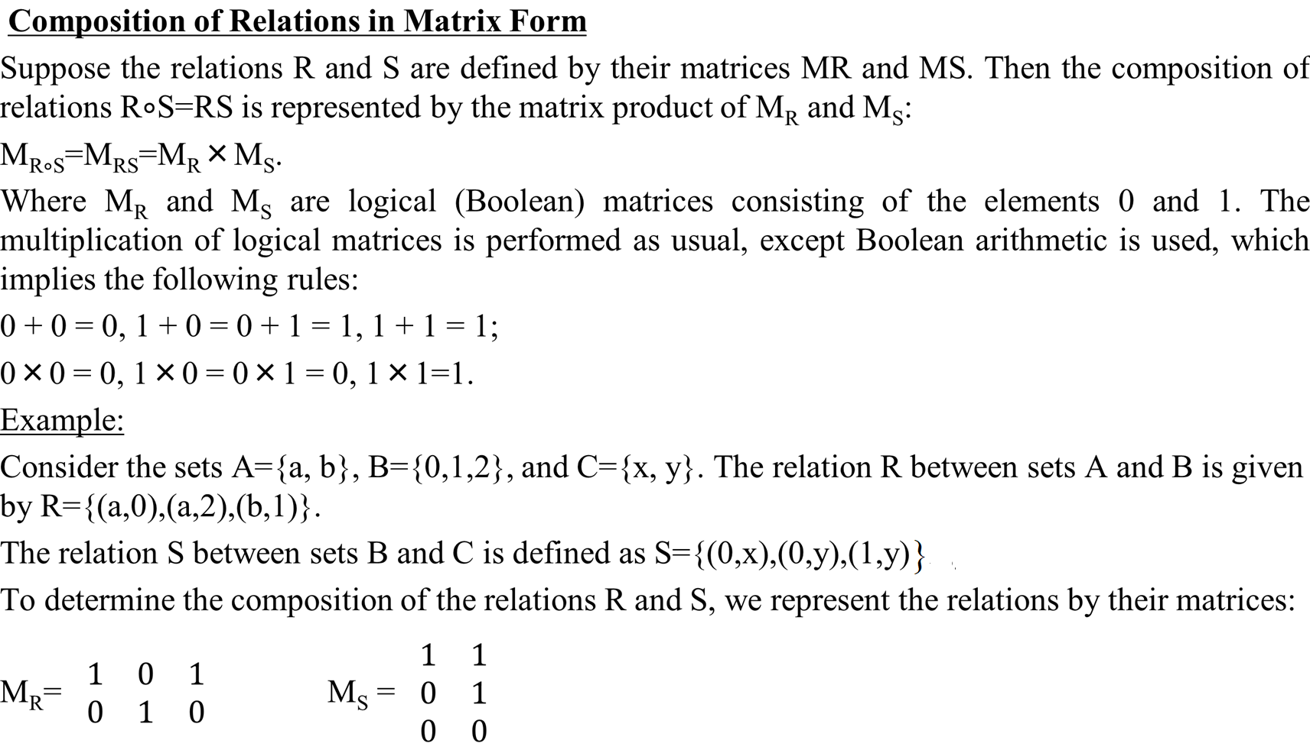
Go, change the world

Slide 45
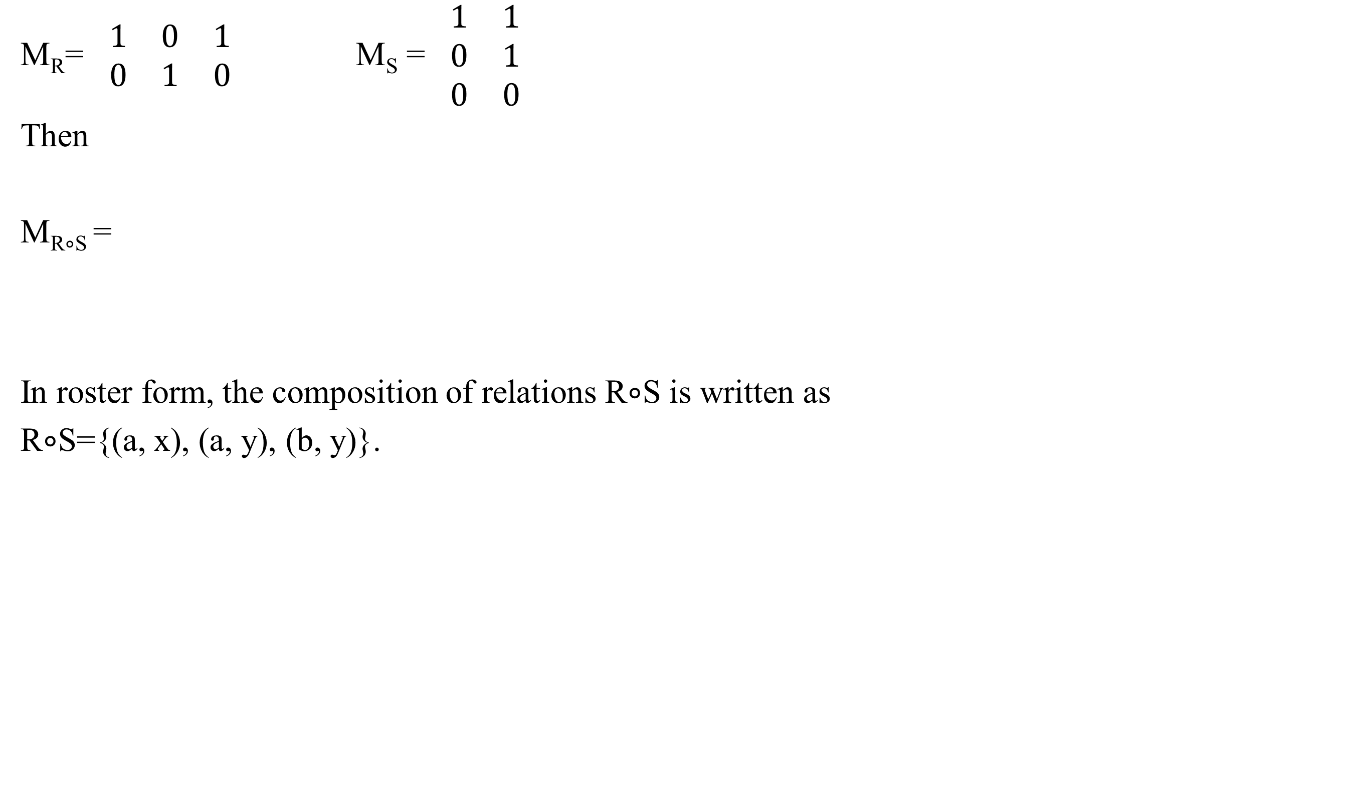
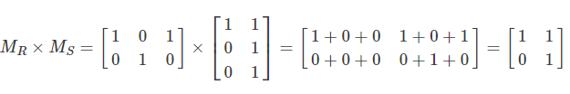
Go, change the world

Slide 46
Go, change the world
Exercise:
The relation S on the set of real numbers R is defined by S={(x, y) ∣ y=x−1}.
Find the composition of relations S².
Soln:
By definition, the composition S² is the relation given by the following property:
S²=S∘S={(x, z) ∣ ∃y∈R : xSy ∧ ySz},
Wher e xSy={(x,y)∣y=x−1},ySz={(y,z)∣z=y−1}.
To determine the composed relation xSz, we solve the system of equations:
{y=x−1 z=y−1,⇒ z = (x−1)−1 = x−2.
Hence, the composition S² is given by S²={(x, z) ∣ z = x−2}

Slide 47
2. The relation S on the set of real numbers R is defined by
S={(x, y) ∣ y=x²+1}.Find the composition of relations S².
Soln: The composition S² is given by the property:
S²=S∘S={(x, z) ∣ ∃y∈S: xSy ∧ ySz},
Where xSy={(x, y) ∣ y =x₂+1},ySz = {(y, z) ∣ z = y²+1}.
We eliminate the variable y in the second relation by substituting the expression y=x²+1 from the first relation: z=y²+1=(x²+1)²+1=x⁴+2x²+2.
So we have: S² = {(x, z) ∣ z = x⁴+2x²+2}.
3. Given the set A={0,1,2} with the relations R={(0,1),(0,2),(1,1),(2,0)} and S={(0,0),(0,2),(1,0),(1,1)}. Find the compositions R∘S and S∘R.
Soln: Consider the composition R∘S.
The first step in this composition is R and the second is S. The first element in R is (0,1). Look for pairs starting with 1 in S: (1,0) and (1,1). Therefore (0,1) in R combined with (1,0) in S gives (0,0). Similarly, (0,1) in R combined with (1,1) in S gives (0,1).
We use the same approach to match all other elements from R. As a result, we find all pairs belonging to the composition R∘S.
R∘S = {(0,0),(0,1),(1,0),(1,1),(2,0),(2,2)}.
Go, change the world

Slide 48
Go, change the world
The composition S∘R implies that S is performed in the first step and R is performed in the second step. Consider the first element of the relation S: (0,0). We see that it matches to the following pairs in R: (0,1) and (0,2). Hence, the composition S∘R contains the elements (0,1) and (0,2). Continuing in this way, we find that S∘R = {(0,0),(0,1),(0,2),(1,1),(1,2)}.
NOTE: the composition of relations is not commutative but associative

Slide 49

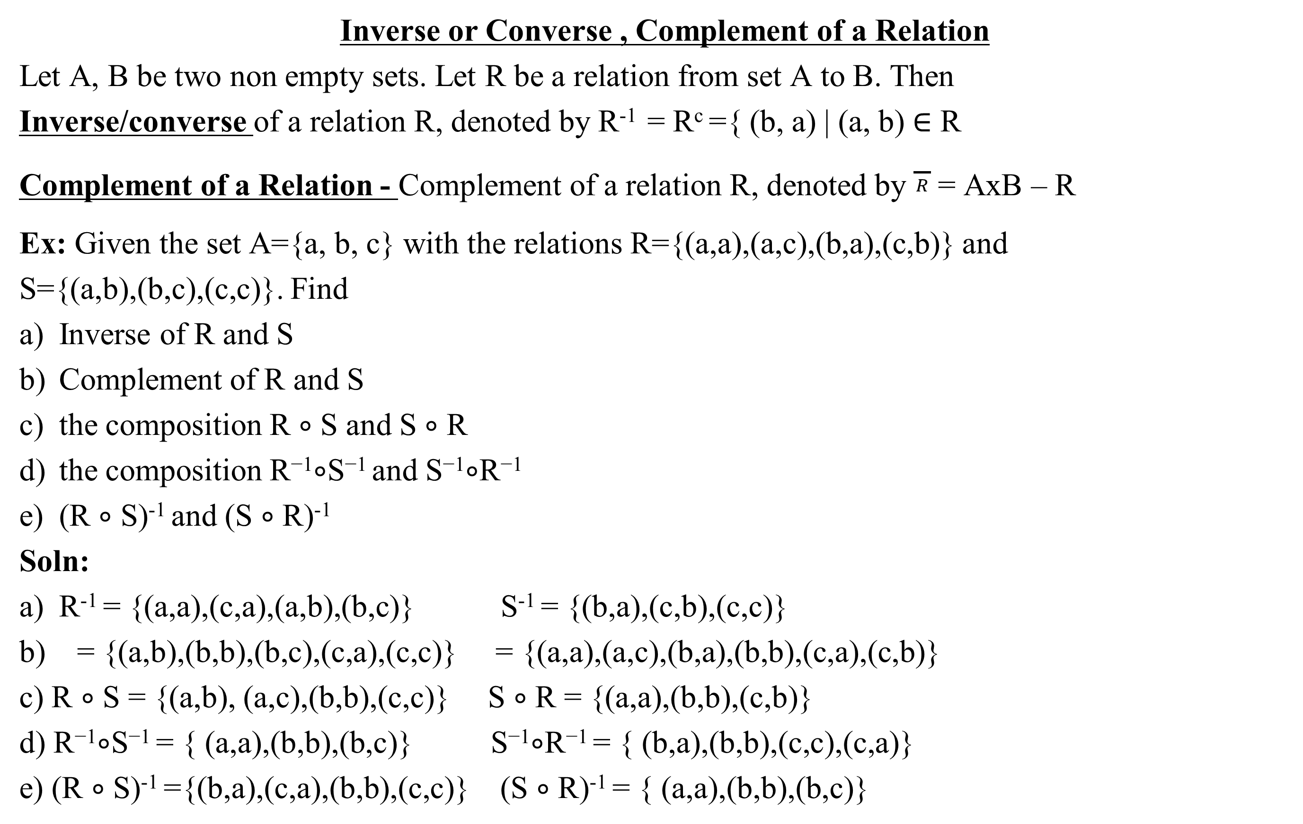
Go, change the world
Inverse or Converse , Complement of a Relation
Let A, B be two non empty sets. Let R be a relation from set A to B. Then
Inverse/converse of a relation R, denoted by R⁻¹ = R^{c} ={ (b, a) | (a, b) ∈ R
Complement of a Relation - Complement of a relation R, denoted by $\frac{}{R}$ = AxB – R
Ex: Given the set A={a, b, c} with the relations R={(a,a),(a,c),(b,a),(c,b)} and
S={(a,b),(b,c),(c,c)}. Find
Inverse of R and S
Complement of R and S
the composition R ∘ S and S ∘ R
the composition R⁻¹∘S⁻¹ and S⁻¹∘R⁻¹
(R ∘ S)⁻¹ and (S ∘ R)⁻¹
Soln:
R⁻¹ = {(a,a),(c,a),(a,b),(b,c)} S⁻¹ = {(b,a),(c,b),(c,c)}
b) = {(a,b),(b,b),(b,c),(c,a),(c,c)} = {(a,a),(a,c),(b,a),(b,b),(c,a),(c,b)}
c) R ∘ S = {(a,b), (a,c),(b,b),(c,c)} S ∘ R = {(a,a),(b,b),(c,b)}
d) R⁻¹∘S⁻¹ = { (a,a),(b,b),(b,c)} S⁻¹∘R⁻¹ = { (b,a),(b,b),(c,c),(c,a)}
e) (R ∘ S)⁻¹ ={(b,a),(c,a),(b,b),(c,c)} (S ∘ R)⁻¹ = { (a,a),(b,b),(b,c)}

Slide 50
Go, change the world
NOTE:
1. (R ∘ S)⁻¹ = S⁻¹ ∘ R⁻¹
2. (S ∘ R)⁻¹ = R⁻¹∘S⁻¹
Exercise:
Consider the set A={1,2,3} with the relations R={(1,1),(1,3),(2,1), (2,2),(3,1)} and S={(1,2),(2,1), (2,2),(3,3)}.
Find
Inverse of R and S
Complement of R and S
the composition R ∘ S and S ∘ R
the composition R⁻¹∘S⁻¹ and S⁻¹∘R⁻¹
(R ∘ S)⁻¹ and (S ∘ R)⁻¹
And show that (R ∘ S)⁻¹ = S⁻¹ ∘ R⁻¹ and (S ∘ R)⁻¹ = R⁻¹∘S⁻¹

Slide 51
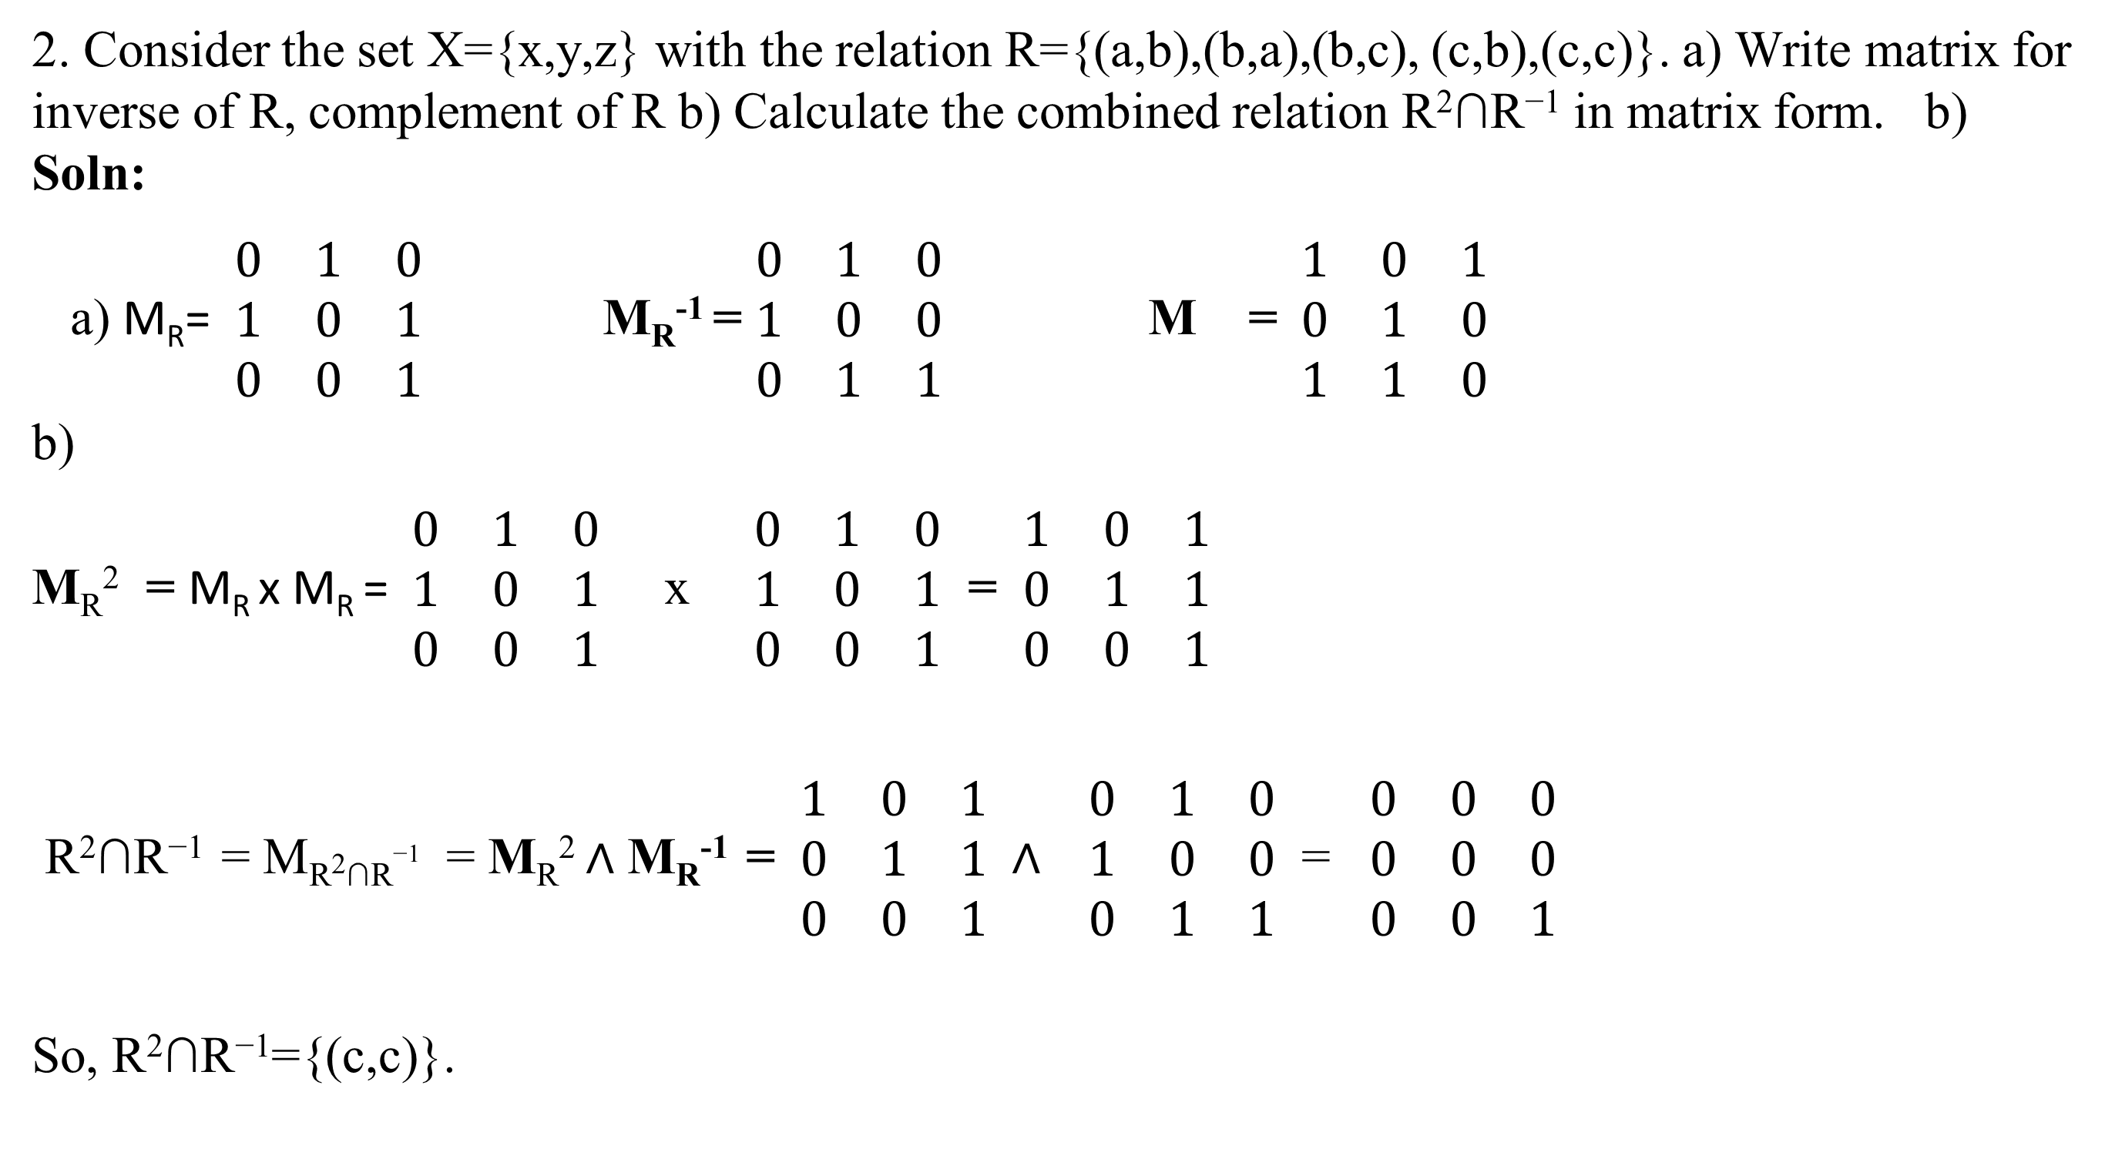

Go, change the world

Slide 52
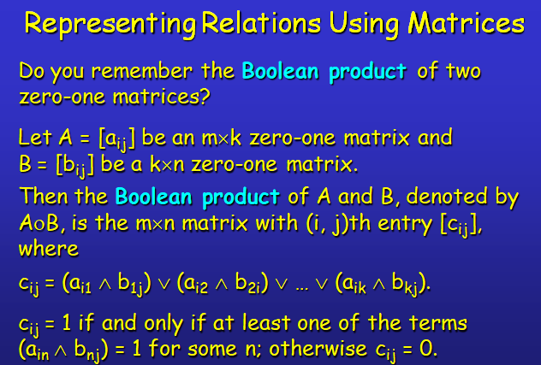
Go, change the world

Slide 53
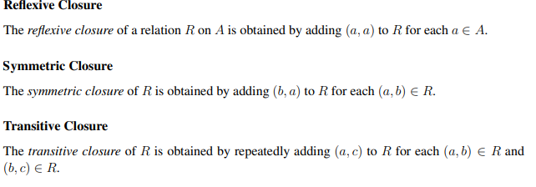
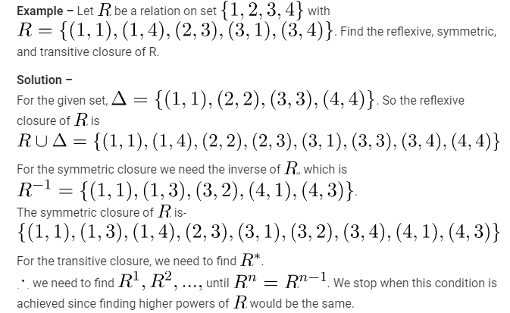
Go, change the world

Slide 54
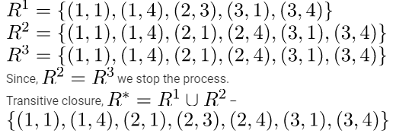
Go, change the world
Example 1
A = {1, 2, 3},R = {(1, 1),(1,2),(2, 1),(1,3),(3, 2)} find the
reflexive closure of R.
Symmetric closure of R
Transitive closure of R
Solution:
a) We know that, R is not reflexive because (2, 2) ∉ R and (3, 3) ∉ R.
Now, Δ= {(1, 1) (2, 2) (3, 3)}
Therefore, R₁ = R U Δ = {(1, 1) (1, 2) (2, 1) (2, 2) (1, 3) (3, 2) (3, 3)}
R₁ is the reflexive closure of R.
b) R⁻¹= { (1,1),(2,1),(1,2),(3,1),(2,3)}
Let R₂ be symmetric closure of R and is R U R⁻¹ = {(1, 1),(1,2),(2, 1),(1,3),(3,1),(3, 2),(2,3)}
c) Transitive closure of R = R₃= R U R* . First find R* = A x A and then union with R.
= {(1, 1),(1,2), (1,3),(2, 1), (2,2),(2,3),(3, 1),(3,2),(3,3)}

Slide 55
Go, change the world
Example 2
A = {1, 2, 3},R = {(1, 1) (1, 2) (2, 1) (2, 3) (3, 1)} find the reflexive closure, symmetric closure and transitive closure of R.
Solution: Δ = {(1,1),(2,2),(3,3)}
Reflexive closure = R₁ = R U Δ = {(1, 1), (1, 2) ,(2, 1),(2,2), (2, 3), (3,1),(3,3)}
Symmetric closure = R2= R U R⁻¹
R⁻¹ = {(1, 1), (2, 1), (1, 2), (3, 2), (1, 3)}
Therefore, R₂ = R U R^{-l} = {(1, 1), (1, 2), (1,3), (2, 1), (2, 3), (3, 1),(3,2)}
R₁ is called the symmetric closure of R.
Transitive closure = R₃= R U R*
R*=R U R² UR³…………=A x A
R₃=A x A

Slide 56
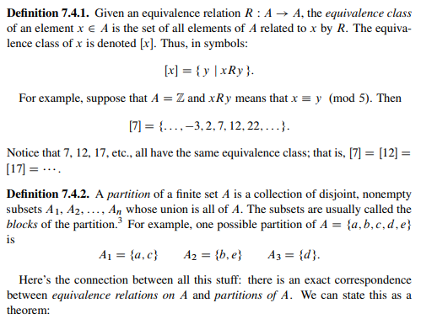
Equivalence class and Partition Set
Go, change the world

Slide 57
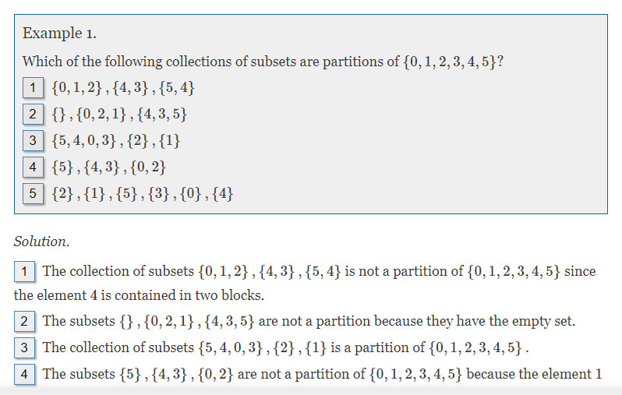
Go, change the world

Slide 58

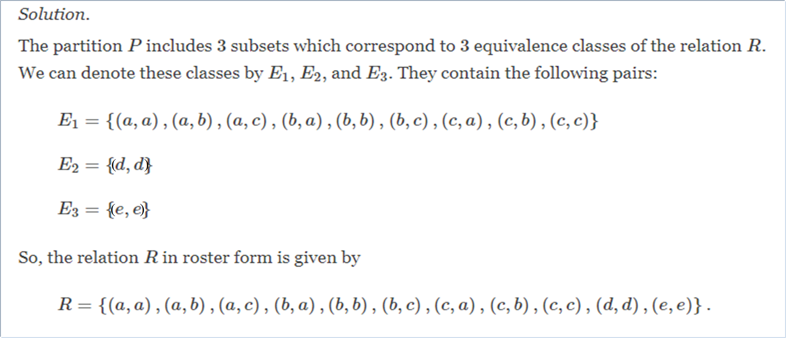
Go, change the world

Slide 59
Equivalence Classes
Go, change the world
Definition: Let R be an equivalence relation on a set A. The set of all elements b that are related to an element a of A is called the equivalence class of a.
That is [a] ={b ∈ A : (b, a) ∈ R}
The equivalence class of a with respect to R is denoted by [a]_{R}.
When only one relation is under consideration, we will delete the subscript R and write [a] for this equivalence class.
If b∈[a]_{R}, b is called a representative of this equivalence class.
Example: Suppose that R is the relation on the set of strings that consist of English letters such that aRb if and only if l(a) = l(b), where l(x) is the length of the string x.
(strings of identical length), what is the equivalence class of the word mouse, denoted by [mouse] ?
Solution: [mouse] is the set of all English words containing five letters.
For example, ‘horse’ would be a representative of this equivalence class.

Slide 60
Equivalence Classes
Go, change the world
Theorem: Let R be an equivalence relation on a set A.
The following statements are equivalent:
aRb
[a] = [b]
[a] ∩ [b] ≠ ∅
Definition: A partition of a set S is a collection of disjoint nonempty subsets of S that have S as their union. In other words, the collection of subsets A_{i}, i∈I, forms a partition of S if and only if (i) A_{i} ≠ ∅ for i∈I
(ii) A_{i} ∩ A_{j} = ∅, if i ≠ j
(iii) ∪_{i∈I} A_{i} = S

Slide 61
Equivalence Classes
Go, change the world
Examples: 1. Let S be the set {u, m, b, r, o, c, k, s}. Do the following collections of sets partition S ?
{{m, o, c, k}, {r, u, b, s}}
yes.
{{c, o, m, b}, {u, s}, {r}}
no (k is missing).
{{b, r, o, c, k}, {m, u, s, t}}
no (t is not in S).
{{u, m, b, r, o, c, k, s}}
yes.
{{b, o, o, k}, {r, u, m}, {c, s}}
yes ({b,o,o,k} = {b,o,k}).
{{u, m, b}, {r, o, c, k, s}, ∅}
no (∅ not allowed).

Slide 62
Go, change the world
Example: 2. Let us assume that Frank, Suzanne and George live in Boston, Stephanie and Max live in Lübeck, and Jennifer lives in Sydney.
Let R be the equivalence relation {(a, b) | a and b live in the same city} on the set
P = {Frank, Suzanne, George, Stephanie, Max, Jennifer}.
Then R = {(Frank, Frank), (Frank, Suzanne),(Frank, George), (Suzanne, Frank), (Suzanne, Suzanne), (Suzanne, George), (George, Frank), (George, Suzanne), (George, George), (Stephanie, Stephanie), (Stephanie, Max), (Max, Stephanie), (Max, Max), (Jennifer, Jennifer)}.
Then the equivalence classes of R are:{{Frank, Suzanne, George}, {Stephanie, Max}, {Jennifer}}.
This is a partition of P.
The equivalence classes of any equivalence relation R defined on a set S constitute a partition of S, because every element in S is assigned to exactly one of the equivalence classes.

Slide 63
Go, change the world
Equivalence Classes
Another example:
3. Let R be the relation {(a, b) | a ≡ b (mod 3)} on the set of integers.
Is R an equivalence relation?
Yes, R is reflexive, symmetric, and transitive.
What are the equivalence classes of R ?
{{…, -6, -3, 0, 3, 6, …}=[0], {…, -5, -2, 1, 4, 7, …}=[1], {…, -4, -1, 2, 5, 8, …}=[2]}
4. A={1,2,3,4,5,6,7,8,9,10}. Relation R is defined by 3 | (x-y). Write the partitions
Ans: [1]={1,4,7,10}
[2]={2,5,8}
[3]={3,6,9}
So A=[1] ∪ [2] ∪[3]

Slide 64
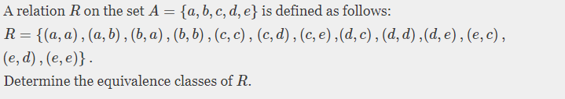
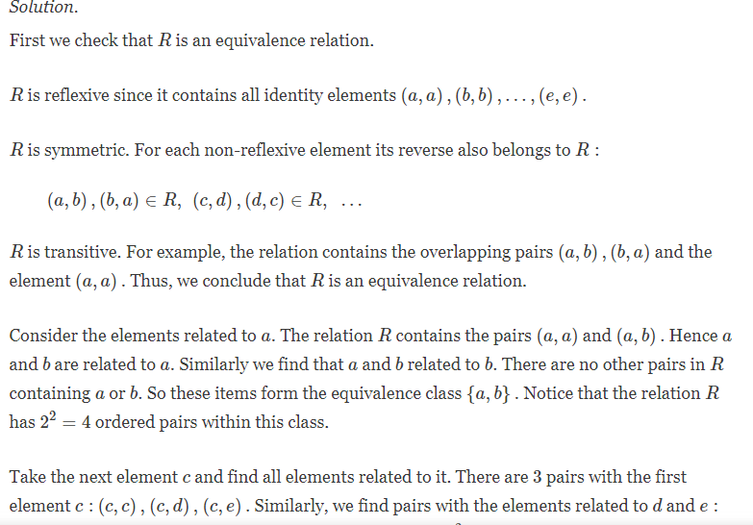
Go, change the world

Slide 65
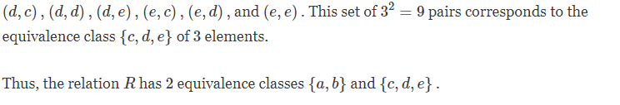
Go, change the world
Let A={1,2,3,4,5,6,7,8} R is an equivalence relation on A which induces the partition {1,4,8} ∪ {3} ∪ {5,6} ∪{2,7}. Determine R.
Soln:
R= {(1,1),(1,4),(1,8),(4,4),(4,1),(4,8),(8,8),(8,1),(8,4),(3,3),(5,5),(5,6),(6,6),(6,5),(2,2),(2,7),(7,2),(7,7)}

Slide 66
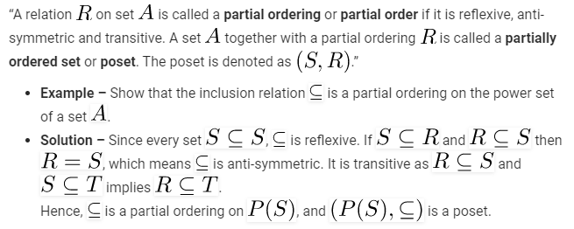
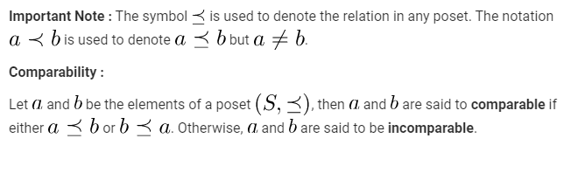
Go, change the world

Slide 67
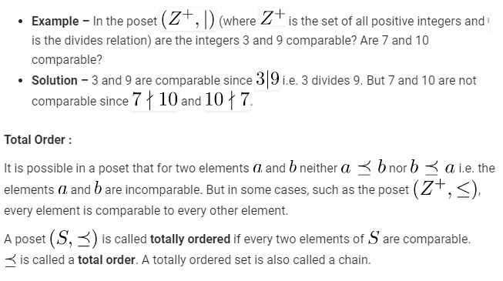
Go, change the world

Slide 68
Go, change the world
Hasse Diagrams :
A partial order, being a relation, can be represented by a di-graph. But most of the edges do not need to be shown since it would be redundant.
For instance, we know that every partial order is reflexive, so it is redundant to show the self-loops on every element of the set on which the partial order is defined.
Every partial order is transitive, so all edges denoting transitivity can be removed.
The directions on the edges can be ignored if all edges are presumed to have only one possible direction, conventionally upwards. In general, a partial order on a finite set can be represented using the following procedure –
Remove all self-loops from all the vertices. This removes all edges showing reflexivity.
Remove all edges which are present due to transitivity i.e. if (a, b) and (b,c) are in the partial order, then remove the edge(a, c) . Furthermore if (c, d) is in the partial order, then remove the edge (a, d).
Arrange all edges such that the initial vertex is below the terminal vertex.
Remove all arrows on the directed edges, since all edges point upwards.

Slide 69
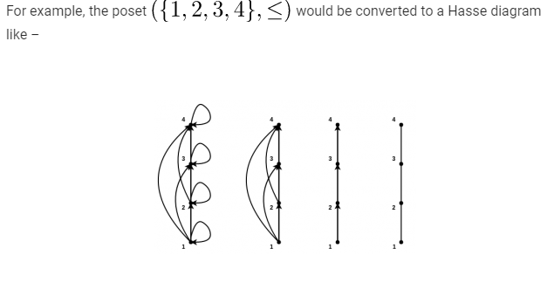
Go, change the world

Slide 70
Go, change the world
Extremums in Posets :
Maximal Elements- An element a in the poset is said to be maximal if there is no element b in the poset such that That is ¬ (∃b ∈ A : aRb) That is ∀ b ∈ A aRb
Minimal Elements- An element a in the poset is said to be minimal if there is no element b in the poset such that That is ¬ (∃b ∈ A : bRa) That is ∀ b ∈ A bRa
Maximal and Minimal elements are easy to find in Hasse diagrams. They are the topmost and bottommost elements respectively.
For example, in the hasse diagram described above, “1” is the minimal element and “4” is the maximal element.
If maximal and minimal are unique, they are also the greatest and least elements of the poset.
Important Note : If the maximal or minimal element is unique, it is called the greatest/maximum or least/minimum element of the poset respectively.
Bounds in Posets :
It is sometimes possible to find an element that is greater than or equal to all the elements in a subset of poset A of ..Such an element is called the upper bound of A . Similarly, we can also find the lower bound of A.
These bounds can be further constrained to get the least upper bound and the greatest lower bound. These bounds are elements which are less than or greater than all the other upper bounds or lower bounds respectively.

Slide 71
Definitions
Go, change the world
Upper bound: Let (A,R) be a poset and A₁ ⊆ A. If u is an element of A such that aRu for all a ∈ A₁, then u is an upper bound of A₁.
Least Upper Bound(LUB): An element x that is an upper bound on a subset A₁ and is less than all other upper bounds of A₁ is called LUB.
Lower bound: Let (A,R) be a poset and A₁ ⊆ A. If l is an element of A such that lRa for all a ∈ A₁, then l is an lower bound of A₁.
Greatest Lower Bound(GLB): An element x that is an lower bound on a subset A₁ and is greater than all other lower bounds of A₁ is called GLB.

Slide 72
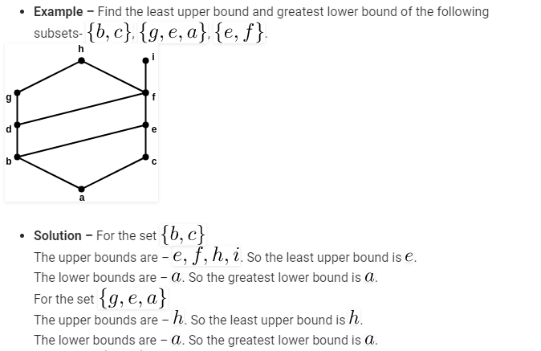
Go, change the world

Slide 73
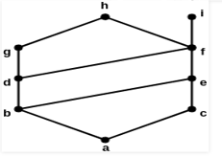
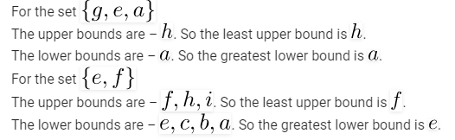
Go, change the world

Slide 74
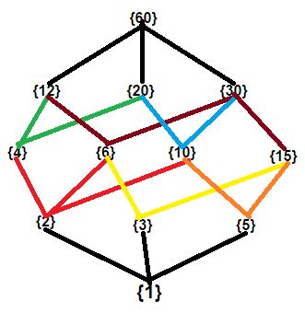
Go, change the world
Exercises:
Draw the hasse diagram for partial ordering: {(a,b) | a|b} on set P={1,2,3,4,5,6,10,12,15,20,30,60} or divisors of 60. Are there greatest and least elements? If so, mention them .
Find LUB and GLB of A₁={4,10}
Soln:
Hasse diagram:
1 and 60 are least and greatest elements.
UB of A₁={20, 60}
LUB of A₁={20}
LB of A₁={1, 2}
GLB of of A₁={2}

Slide 75
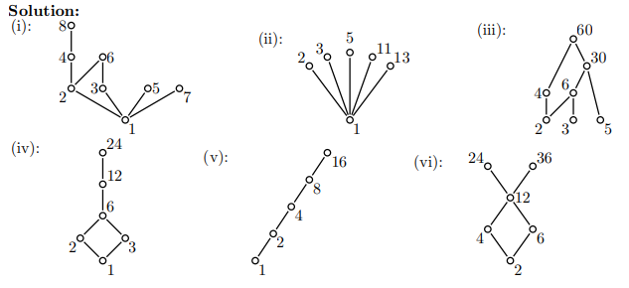
Go, change the world
Exercises:
2. Draw a Hasse diagram for (A,) (divisibility relation), where
(i) A = {1, 2, 3, 4, 5, 6, 7, 8}; (iii) A = {2, 3, 4, 5, 6, 30, 60}; (v) A = {1, 2, 4, 8, 16, 32, 64};
(ii) A = {1, 2, 3, 5, 11, 13}; (iv) A = {1, 2, 3, 6, 12, 24}; (vi) A = {2, 4, 6, 12, 24, 36}.

Slide 76
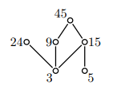
Go, change the world
Exercises:
3. Consider the poset (A={3, 5, 9, 15, 24, 45},divisibilty), that is, the divisibility relation. (i) Draw its Hasse diagram. (ii) Find its maxima, minima, greatest and least elements when they exist. (iii) Find maxima, minima, greatest and least elements of the set M = {3, 9, 15}, when they exist. iv) find LB,UB,GLB,LUB of M which is a subset of given poset A.
Soln:
ii) Minimal elements = {3,5}
maximal elements = {24,45}
least and greatest elements does not exists.
iii) M = {3, 9, 15}
Minimal elements of M = {3}
maximal elements of M= {9,15}
least element of M={3}
greatest element of M does not exists
iv) LB=GLB of M = { 3} UB = LUB of M= { 45}

Slide 77
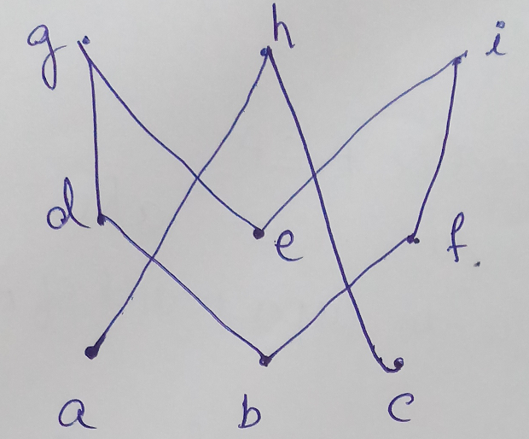
Go, change the world
Exercises:
4. Consider the poset given below i) find minimal, maximal,greatest,least elements if any.
ii) Find LUB and GLB of {d, e, f} iii) Find LUB and GLB of {a, c}
iv) Find LUB and GLB of {b, d}
Soln:
i) Minimal elements = { a,b,c} maximal elements = {g,h,i}
least and greatest elements does not exists.
ii) A = {d, e, f}
LB of A= Φ No GLB exists
UB of A=Φ No LUB exists
iii) B = {a,c}
LB of B= Φ No GLB exists
UB of B={h} LUB ={h}
iv) C = {b,d}
LB of C= {b} GLB={b}
UB of C={d,g} LUB ={d}

Slide 78
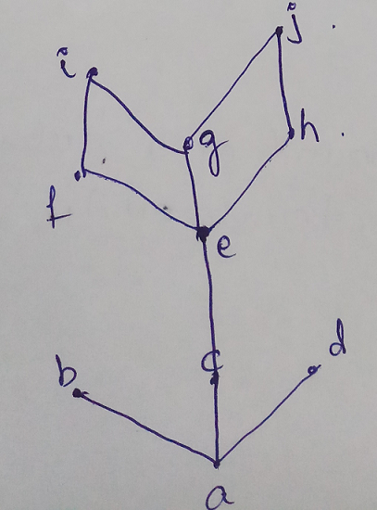
Go, change the world
Exercises:
5. Consider the poset given below i) find minimal, maximal,greatest,least elements if any.
ii) Find LUB and GLB of {c, e} iii) Find LUB and GLB of {b, i}
Soln:
i) Minimal elements = { a} maximal elements = {b,d,i,j}
least element = {a}
greatest element does not exists.
ii) A = {c, e}
LB of A= {a, c} GLB={c}
UB of A={c,e,f,g,h,i,j} LUB= {e}
iii) B = {b, i}
LB of B= {a} GLB= {a}
UB of B= Φ No LUB exists

Slide 79
Go, change the world
Thm: Prove that Poset (A,R) has a least element, it is unique .
Proof: Suppose x,y ∈ A and both are least elements.
Then since x is least element, xRy
And also since y is least element, yRx.
Since R is Antisymmetric, it follows that x=y.
Therefore Poset (A,R) has a unique least element.
Lattices: A lattice is a poset in which every pair of elements has both LUB and GLB. That is if (A,R) is a poset and if for all x, y ∈ A, LUB({x, y}) and
GLB({x, y}) exists in A, then (A, R) is called a Lattice.
Ex: A={1,2,3} and R is a elation defined on P(A)

Slide 80
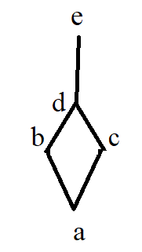
Go, change the world
Topological ordering:Topological sorting for Directed Acyclic Graph (DAG) is a linear ordering of vertices such that for every directed edge u v, vertex u comes before v in the ordering.
For fig 1,
1: a<b<c<d<e<f<g<h<i
2: a<c<h<b<d<f<e<g<I
…………..
For fig2, i) a<b<c<d<e
ii)a<c<b<d<e fig1 fig2

Slide 81

RV College of
Engineering
Functions
Go, change the world
Definition: Let A and B be two sets. A function f from A to B is a rule that assigned to each element x in A exactly one element y in B. It is denoted by f: A → B
Function -A type of relation where there is exactly one output for every input.
For every x there is exactly one y.
Value of f: If x is an element of A and y is an element of B assigned to x, written y = f(x) and call function value of f at x. The element y is called the image of x under f.
Example: A = {1, 2, 3, 4} and B= {a, b, c, d}
R = {(1, a), (2, b), (3, c), {4, d)} S = {(1, b), (1, d), (2, d)}
R is a function and S is not a function. Since the element 1 has two images b and d . Therefore S is not a function.

Slide 82

Go, change the world
Example: Let A = {1, 2, 3, 4} determine whether or not the following relations on A are function.
1. f= {(2, 3), (1, 4), (2, 1), (3,2), (4, 4)}
(Since element 2 has 2 images 3 and 1, f is not a function.)
2. g={(3,1),(4,2),(1,1)} g is not a function since 2 is not associated with any element.
3. h={(2,1),(3,4),(1,4),(2,1),(4,4)} h is a function
4. Let A= {0, ±1, ±2, 3}. Consider the function F: A→ R, where R is the set of all real numbers, defined by f(x) =x³ -2x² +3x+1 for x∈A. Find the range of f.
f (0) =1
f (1) =1-2+3+1=3 f (-1) =-1-2-3+1=-5 f (2) =8-8-6+1=7 f (-2) =-8-8-6+1= -21
f (3) =27-18+9+1=19
Range = {1, 3,-5, 7,-21, 19}

Slide 83
Go, change the world
5. If A= {0, ±1, ±2} and f: A → R is defined by f(x) =x²-x+1, x ∈ A find the range.
f (0) =1
f (1) =1-1+1=1
f (-1) =1+1+1=3
f (2) =4-2+1=3
f (-2) =4+2+1=7
Range = {1, 3, 7}

Slide 84
Go, change the world
6. f(x) = ⌊x⌋ = greatest integer ≤ x
Ex: ⌊3.8⌋ = 3 ⌊-3.4⌋ = -4
7. f(x) = ⌈x⌉ = least integer ≥ x
Ex: ⌈3.01⌉=4 ⌈-3.01⌉ = -3
8. Truncation –
Ex: trunc(3.4)=3 trunc(+ve no)= ⌊+ve no⌋
trunc(-7.22)=-7 trunc(-ve no)= ⌈-ve no⌉

Slide 85
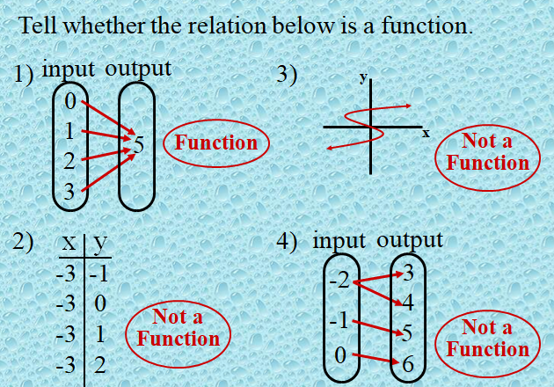
Go, change the world
Evaluate the function over the domain,
x = -1, x = 0, x = 2.

Slide 86
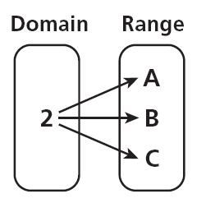
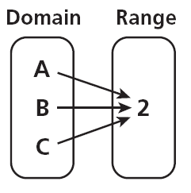
Go, change the world
3. Which relation mapping represents a function?
Is this a relation? YES
Is this a function? YES
Choice One Choice Two
3
1
0
–1
2
3
2
–1
3
2
3
–2
0
Is this a function? No
Choice 1
Is this still a relation? Yes
4. Which relation mapping represents a function?
A. B.
B

Slide 87
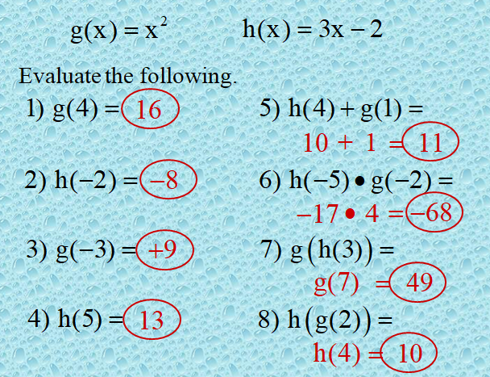
Go, change the world

Slide 88
Go, change the world
Counting on functions:
Let |A|=m, |B|=n That is A={a₁,a₂,……….a_{m}} and B={b₁,b₂,…………..b_{n}}
F: A → B is {(a₁,x₁),(a₂,x₂),………………(a_{m},x_{m})} where
x₁ can be any element from set B that is {b₁,b₂,…………..b_{n}},
x₂ can be any element from set B that is {b₁,b₂,…………..b_{n}},
.
.
x_{m} can be any element from set B that is {b₁,b₂,…………..b_{n}},
By product rule there are n^{m} = |B|^{|A|} functions from A to B.
That is for 1st element n choices, 2nd element n choices……… m^{th} element n choices.
n n n n ……………………= n^{m}

Slide 89
Go, change the world
Ex: If |A| = 3, |B| = 4 Then f₁: A → B, f₂: B → A Find the # of possible f₁ and f_{2.}
Soln: Since f₁ is a function from A to B, # of possible f₁ = |B|^{|A|} = 4³⁼64
Since f₂ is a function from B to A, # of possible f₂ = |A|^{|B|} = 3⁴⁼81
NOTE:
1. If f₁: A → B, if we interchange components of ordered pairs of f, we may not always get a function from B to A.

Slide 90
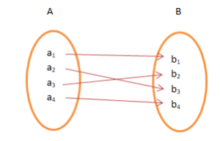
Go, change the world
Types of functions
1.One-to-one function or injective
A function f: A→B is injective or one-to-one function if for every b ∈ B, there exists at most one a ∈ A such that f(a) = b. This means a function f is injective if f(a₁) = f(a₂) ⇒ a₁ = a_{2.}
That is if f is a function from A to B then every element of B appears at most once as the image of an element of A. or every element of A has distinct image in B.
Example
1. f: N →N, f(x) = 5x is injective.
2. f: Z⁺→Z⁺, f(x) = x² is injective.
3. f: Z→Z, f(x) = x² is not injective as (–x)²= x²
4. Show that the function f: R → R defined by f(x)=3x+7 ∀x ∈R.
Proof: let x₁,x₂ ∈ R, f(x₁)= f(x₂) ⇒ x₁ = x₂
So, f is one to one.
5. Is function f: R → R defined by f(x)=x²-x ∀x∈R a one to one?
Soln: Let x₁,x₂ ∈ R, f(x₁)= f(x₂) ⇏ x₁ = x₂ Since f(0)= 0 and f(1) =0 but 0 ≠ 1
∴ f is not one to one.

Slide 91
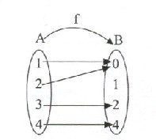
RV College of
Engineering
Go, change the world
Types of functions
2. Many to one function
A function f is said to be a many-to-one function if f(a) = f(b), for some a, b ∈ A.
Example:
Here, f (1) = f (2), where 1,2 ∈ A
3. Onto or surjection function:
A function f: A →B is surjective (onto) if the image of f equals its range.
Equivalently, for every b ∈ B, there exists some a ∈ A such that f(a) = b.
This means that for any y in B, there exists some x in A such that y = f(x).
Example 1. f : Z⁺→Z⁺ , f(x) = x² is not surjective.
2. f : Z→Z , f(x) = x² is not surjective since –ve integers do not have pre image.
3. f : R→R, f(x) = x³ is surjective since co domain of f = R = range of f
4. f : R→R⁺ , f(x) = x² is onto.
NOTE:
For onto functions, if f: A → B range = B
Onto function exists if |A| ≥ |B| ie m ≥ n

Slide 92
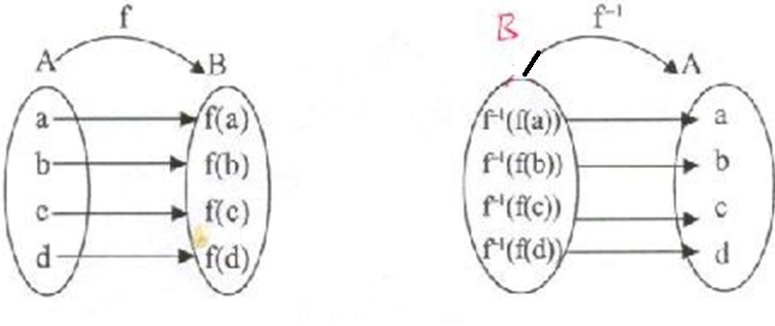
Go, change the world
4.One-to-one correspondence
A function f: A →B is bijective or one-to-one correspondent if and only if f is both injective and surjective.
Problem: Prove that a function f: R→R defined by f(x) = 2x – 3 is a bijective function.
Explanation: We have to prove this function is both injective and surjective. If f(x1) = f(x2), then 2x1 – 3 = 2x2 – 3 and it implies that x1 = x2. Hence, f is injective. Here, 2x – 3= y So, x = (y+3)/2 which belongs to R and f(x) = y. Hence, f is surjective. Since f is both surjective and injective, we can say f is bijective.
5.Invertible function: A function f: A → B is said to be an invertible function if its inverse relation, f⁻¹ is a function from B → A.
If f: A → B is Bijection, then f⁻¹ : B → A exists, f is said to be invertible.
6.Identity function
A function f: A → A such that f (a) = a, if a Є A is called the identity function or identity mapping on A denoted by I_{A}.
Dom (f) = Ran (f) = A

Slide 93
Go, change the world
7.Constant function
A function f: A → B such that f (a) =c, ∀a∈ dom (f) where c is a fixed element of B, is called a constant function.
8.Into function
A function f: A → B is said to be an into function if there exist some b in B which is not the image of any a in A under f. (if f is not onto)
Defn: If f and g are functions from A-> B, f=g if f(a)=g(a) ∀a ∈ A.
Ex: f, g: R→Z

Slide 94
Go, change the world
NOTE: # of one to one functions where f: A →B with |A|=m, |B|=n
That is A={a₁,a₂,……….a_{m}} and B={b₁,b₂,…………..b_{n}}
Case 1: if m > n then one to one function not possible
Case 2: if m ≤ n, a one to one function has form {(a₁,x₁),(a₂,x₂),………………(a_{m},x_{m})} where
there are n choices for x1, (n-1) choices for x2, (n-2) choices for x3…………n-(m-1) choices for x_{m}.
By product rule, no of one to one functions from A to B is n (n-1) (n-2)………..n-m+1 = nPm
Exercises:
If there are 2187 functions f: A → B, |B|=3, what is |A|?
Soln: f: A → B, then the no. of functions from A to B = |B|^{|A|} = 2187 = 3⁷
∴ |A|= 7
2. Let a₁,a₂,……… be an integer sequence defined recursively
i) a₁=1
ii) for all n∈Z+, n≥2, a_{n} =2a_{⌊n/2⌋}.
Determine a_{n} for 2≤n≤8.
Soln: a₁=1
a₂=2 a_{⌊2/2⌋}⁼ 2a₁ = 2 a₃=2 a_{⌊3/2⌋}⁼ 2a₁ = 2 a₄=2 a_{⌊4/2⌋}⁼ 2a₁ = 2(2)=4
a₅=2 a_{⌊5/2⌋}⁼ 2a₂ = 2(2)=4 a₆=2 a_{⌊6/2⌋}⁼ 2a₃ = 2(2) = 4 a₇=2 a_{⌊7/2⌋}⁼ 2a₃ = 2(2)=4
a₈=2 a_{⌊8/2⌋}⁼ 2a₄ = 2(4)=8

Slide 95
Go, change the world
3. A={1,2,3,4,5} If there are 6720 injective functions f: A → B, what is |B|?
Soln: f: A → B, then the no. of injective functions from A to B = |B| P _{|A|} = 6720
|A|=m=5
nPm=n!/(n-m)!=8720
= n!/(n-5)!=8720
∴ n=|B|= 8
Definition:
1. If f: A →B and A₁ ⊆A, then f(A₁) = { b ∈B | b=f(a), for some a ∈ A} and
f(A₁) is called the image of A₁ under f.
Ex: If A={1,2,3,4,5} B={w, x, y, z} f: A →B given by f ={(1,w),(2,x),(3,x),(4,y),(5,y)} and A₁={1,2} A₂={2,3,4,5}. Find the images of A₁ and A₂ under f.
Soln:
f(A₁)={f(1),f(2)}={w, x}
f(A₂)={f(2),f(3),f(4),f(5)}={x,y}
2. If g: R →R, g(x)=x² then g(R)=[0, +∞]
3. If g: Z →Z, g(x)=x²
Image of Z under g(z)={0,1,4,9,6…….} & for A₁=[-2,1] we get
g(A₁)=[0,4] ∵ g(-2)=4, g(-1)=1,g(0)=0,g(1)=1,g(2)=4
∴ g(A₁)=[0,4]

Slide 96
Go, change the world
4. If h: Z →Z, h(x, y)=2x+3y.
Here domain of h is ZxZ and codomain is Z
h(0,0)=0
h(-3,7)=2(-3)+3(7)=15
h(2,-1)=2(2)+3(-1)=1
For any n ∈Z, h(2n,-1)=2(2n)+3(-n) = n
h(ZxZ)=range of h =Z
For A₁={(0, n)| n ∈Z⁺} = 0xZ⁺ ⊆ ZxZ, the image of A₁ under h is h(A₁)={3,6,9……….}={3n | n∈Z⁺ }
Theorem: Let f: A →B , A₁,A₂ ⊆A then a) f(A₁ ∪ A₂) = f(A₁) ∪ f(A₂)
b) f(A₁ ∩ A₂) = f(A₁) ∩ f(A₂) when f is injective
c) f(A₁ ∩ A₂) ⊆ f(A₁) ∩ f(A₂)
Proof:
For each b ∈B, b ∈ f(A₁ ∪ A₂) ⇒ b=f(a) for some a ∈(A₁ ∪ A₂)
⇒ b=f(a) for some a ∈ A₁ or b=f(a) for some a ∈ A₂
⇒ b ∈f(A₁) or b∈ f(A₂)
⇒ b ∈f(A₁) ∪ f(A₂)
∴ f(A₁ ∪ A₂) = f(A₁) ∪ f(A₂)

Slide 97
Go, change the world
c) If b ∈ f(A₁ ∩ A₂)
⇒ b=f(a) for some a∈A₁∩A₂
⇒ b ∈f(a) for some a∈A₁ and b ∈f(a) for some a∈A₂
⇒ b ∈f(A₁) and b ∈ f(A₂)
⇒ b ∈f(A₁) ∩ f(A₂)
∴ f(A₁ ∩ A₂) ⊆ f(A₁) ∩ f(A₂)
Definition:
1. If f: A →B , A₁ ⊆A then f/A₁ : A₁ →B is called the restriction of f to A₁ if f/A₁(a) = f(a) for all a ∈ A₁.
2. Let A₁ ⊆A & f: A₁ →B, and g(a)=f(a) for all a ∈ A_{1 ,}then we call g an extension of f to A.
Ex: A={w, x, y, z} B={1,2,3,4,5} f: A →B with f(w)=1, f(x)=3, f(y)=5, f(z)=4 . If A₁ = {w, y, z} Find g, the restriction of f
Soln:
The restriction of f is g: A₁ →B is g(w)=1,g(y)=5,g(z)=4.
Here g is the restriction of f and f is an extension of g.
There are 5 ways to extend g from A₁ to A.[ x can be mapped to any of 5 elements of B]

Slide 98
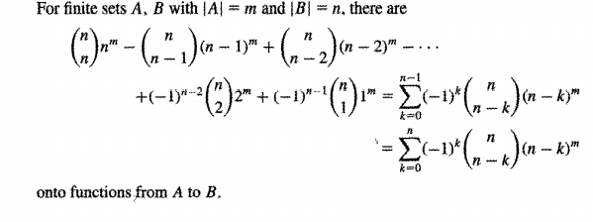
Go, change the world
Ex:
A={x, y, z} B={1,2}. All functions are onto except:
f1={(x,1),(y,1),(z,1)} f2={(x,2),(y,2),(z,2)}
∴ there are n^{m}-2 onto functions from A to B
2. Let B={1,2,3} for any set A with |A|=m ≥3, there are 3C₃ 3^{m} – 3C₂ 2^{m} + 3C₁ 1^{m} onto functions from A to B. In general,
if |A|=m, |B|=n there are nC_{n} n^{m} – nC_{n-1} (n-1)^{m} + nC_{n-2} (n-2)^{m} - ……..(-1)^{n-1} nC₁ 1^{m}
^{I}

Slide 99
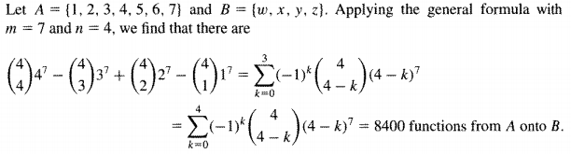
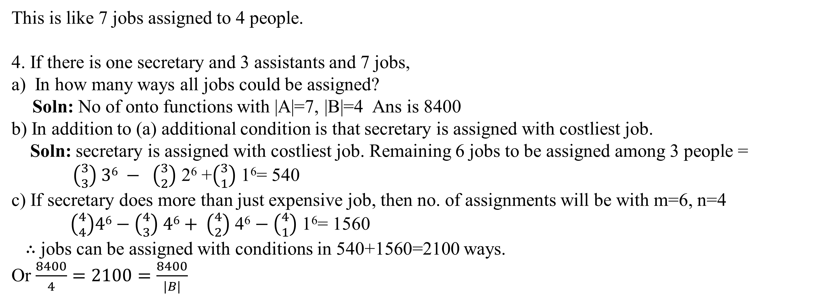
Go, change the world
This is like 7 jobs assigned to 4 people.
4. If there is one secretary and 3 assistants and 7 jobs,
In how many ways all jobs could be assigned?
Soln: No of onto functions with |A|=7, |B|=4 Ans is 8400
b) In addition to (a) additional condition is that secretary is assigned with costliest job.
Soln: secretary is assigned with costliest job. Remaining 6 jobs to be assigned among 3 people =
$\left({3 \atop 3}\right) 36 − \left({3 \atop 2}\right)$ 2⁶ +$\left({3 \atop 1}\right)$ 1⁶= 540
c) If secretary does more than just expensive job, then no. of assignments will be with m=6, n=4
$\left({4 \atop 4}\right)46−\left({4 \atop 3}\right) 46+ \left({4 \atop 2}\right)$ 4⁶ $− \left({4 \atop 1}\right)$ 1⁶= 1560
∴ jobs can be assigned with conditions in 540+1560=2100 ways.
Or $\frac{8400}{4}=2100=\frac{8400}{|B|}$

Slide 100
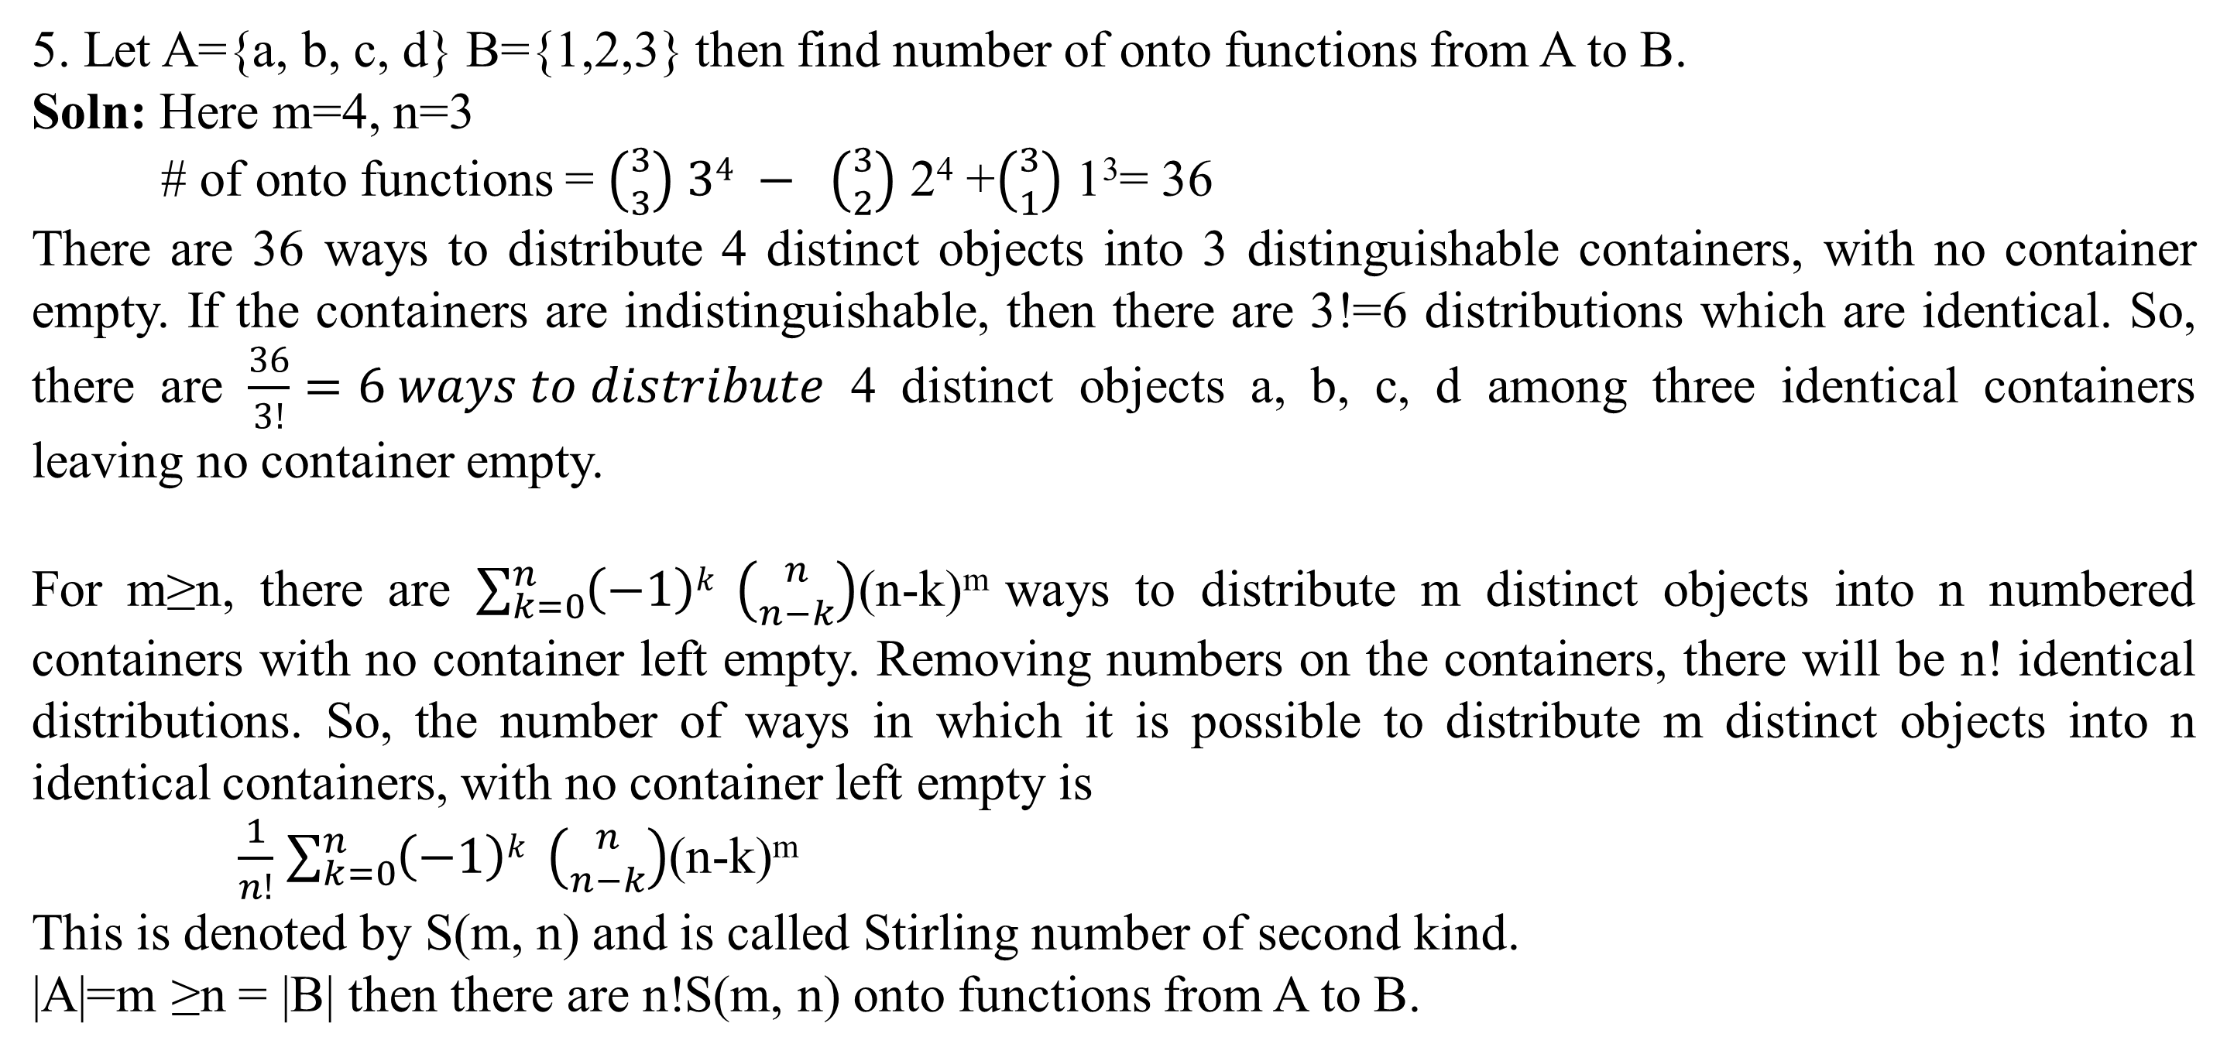
Go, change the world
5. Let A={a, b, c, d} B={1,2,3} then find number of onto functions from A to B.
Soln: Here m=4, n=3
# of onto functions = $\left({3 \atop 3}\right) 34 − \left({3 \atop 2}\right)$ 2⁴ +$\left({3 \atop 1}\right)$ 1³= 36
There are 36 ways to distribute 4 distinct objects into 3 distinguishable containers, with no container empty. If the containers are indistinguishable, then there are 3!=6 distributions which are identical. So, there are $\frac{36}{3!}=6 ways to distribute$ 4 distinct objects a, b, c, d among three identical containers leaving no container empty.
For m≥n, there are $\sum_{k=0}^{n}{\left(−1\right)k} \left({n \atop n−k}\right)$(n-k)^{m} ways to distribute m distinct objects into n numbered containers with no container left empty. Removing numbers on the containers, there will be n! identical distributions. So, the number of ways in which it is possible to distribute m distinct objects into n identical containers, with no container left empty is
$\frac{1}{n!}$ $\sum_{k=0}^{n}{\left(−1\right)k} \left({n \atop n−k}\right)$(n-k)^{m}
This is denoted by S(m, n) and is called Stirling number of second kind.
|A|=m ≥n = |B| then there are n!S(m, n) onto functions from A to B.

Slide 101
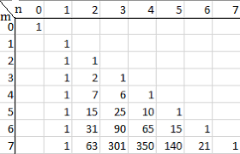
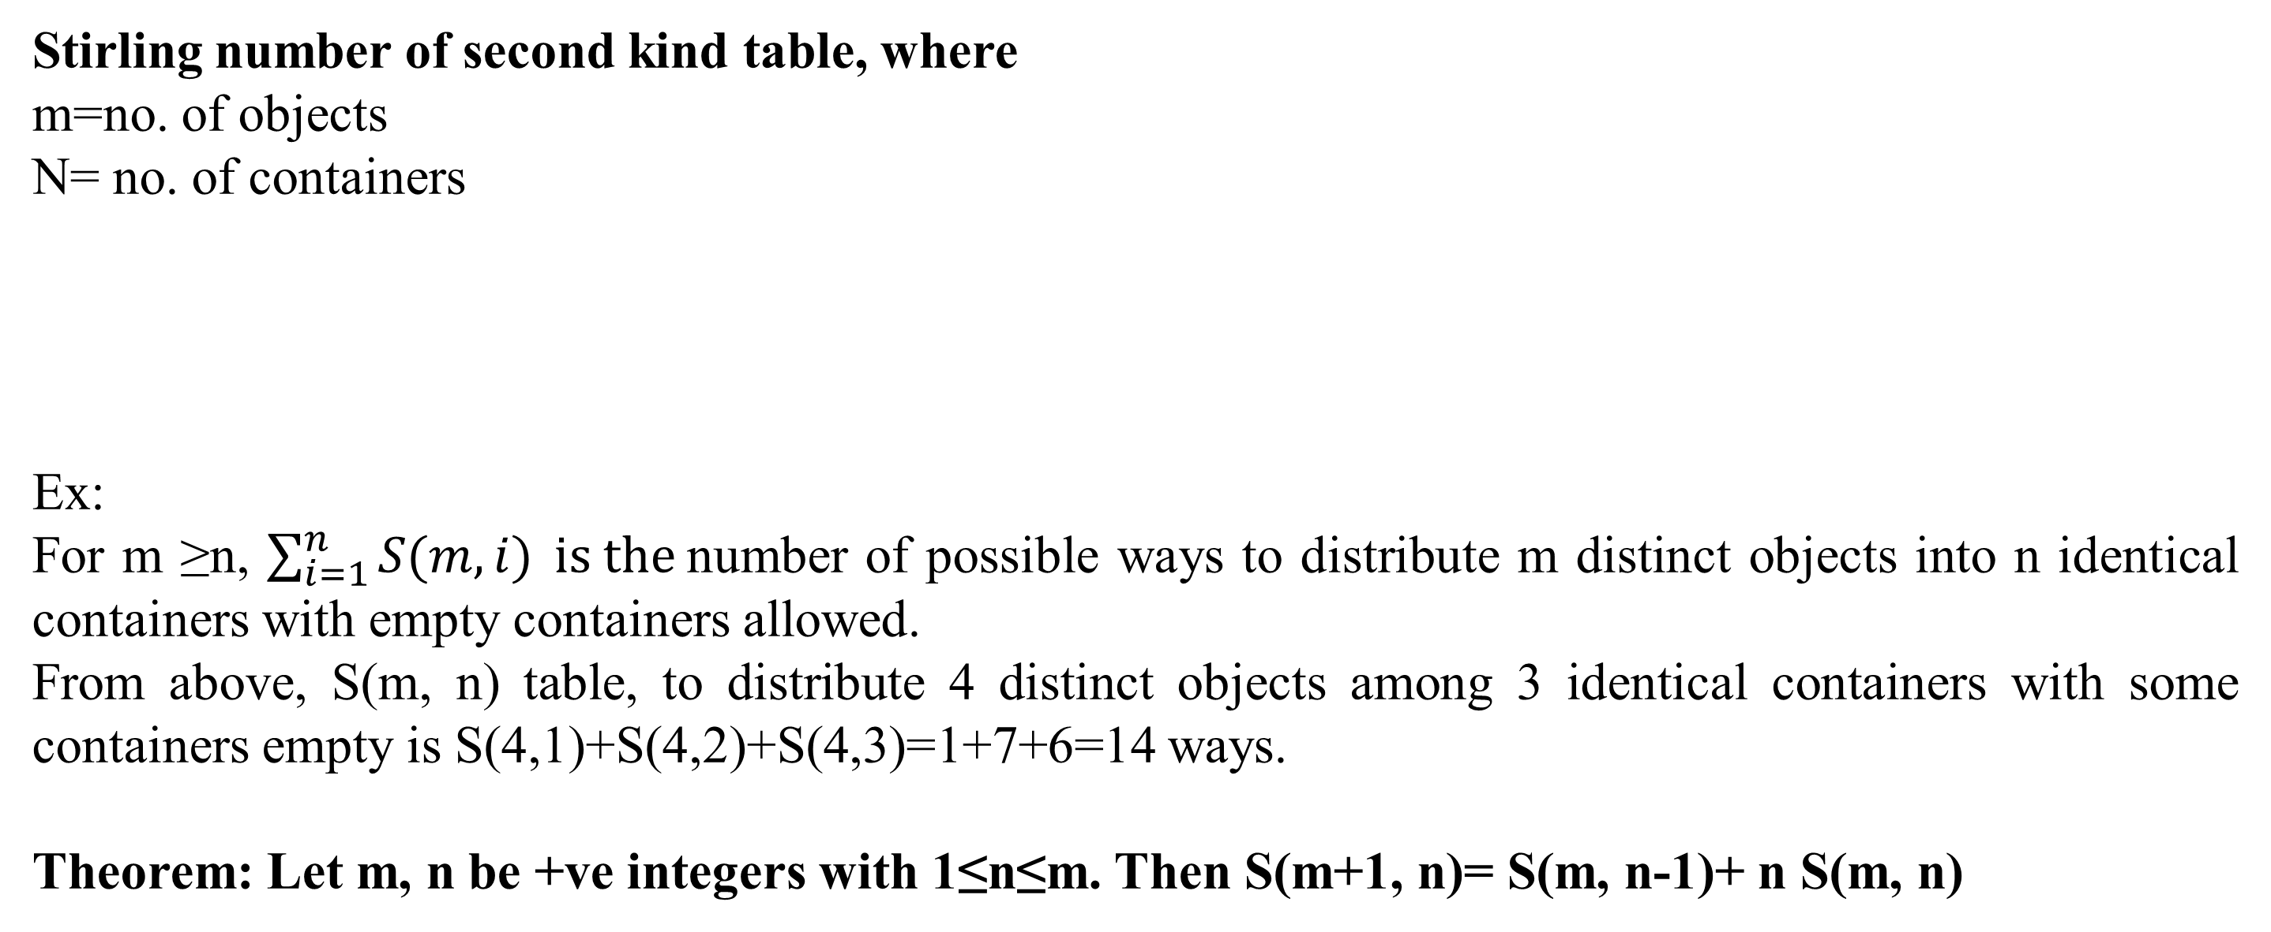
Go, change the world
Stirling number of second kind table, where
m=no. of objects
N= no. of containers
Ex:
For m ≥n, $\sum_{i=1}^{n}{S(m,i)} is the$number of possible ways to distribute m distinct objects into n identical containers with empty containers allowed.
From above, S(m, n) table, to distribute 4 distinct objects among 3 identical containers with some containers empty is S(4,1)+S(4,2)+S(4,3)=1+7+6=14 ways.
Theorem: Let m, n be +ve integers with 1≤n≤m. Then S(m+1, n)= S(m, n-1)+ n S(m, n)

Slide 102
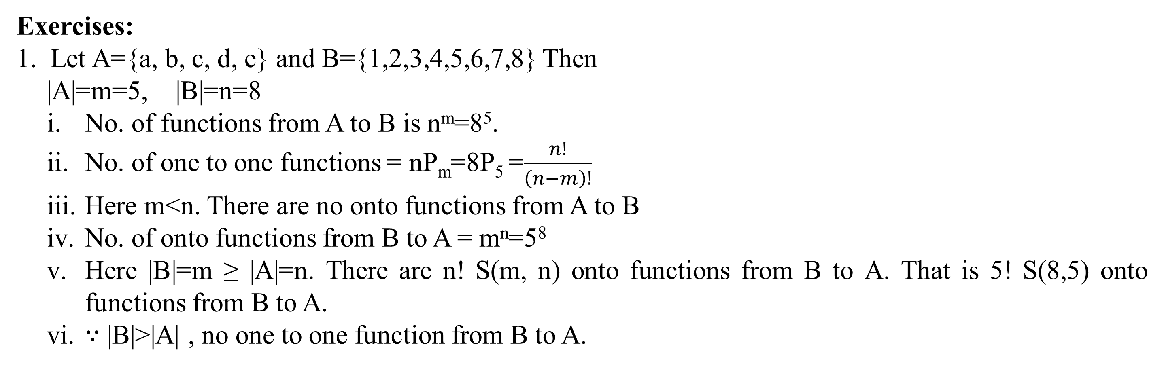
RV College of
Engineering
Go, change the world
Exercises:
Let A={a, b, c, d, e} and B={1,2,3,4,5,6,7,8} Then
|A|=m=5, |B|=n=8
No. of functions from A to B is n^{m}=8⁵.
No. of one to one functions = nP_{m}=8P₅ =$\frac{n!}{\left(n−m\right)!}$
Here m<n. There are no onto functions from A to B
No. of onto functions from B to A = m^{n}=5⁸
Here |B|=m ≥ |A|=n. There are n! S(m, n) onto functions from B to A. That is 5! S(8,5) onto functions from B to A.
∵ |B|>|A| , no one to one function from B to A.

Slide 103
Go, change the world
A function f: A →B is bijective or one-to-one correspondent if and only if f is both injective and surjective.
Problem: Prove that a function f: R→R defined by f(x) = 2x – 3 is a bijective function.
Explanation: We have to prove this function is both injective and surjective. If f(x₁) = f(x₂), then 2x₁ – 3 = 2x₂ – 3 and it implies that x₁ = x₂. Hence, f is injective. Here, 2x – 3= y So, x = (y+3)/2 which belongs to R and f(x) = y. Hence, f is surjective. Since f is both surjective and injective, we can say f is bijective.

Slide 104
Go, change the world
Exercise:
There are 6 programmers who can assist 10 dept. In how many ways these depts. Be assisted by 6 programmers so that each is working at least at one dept.
Soln: Here |A|=10, |B|=6
# of assignments of dept to programmers with no programmer is idle is the # of onto functions from A to B = 6! S(10,6)
WKT S(m+1, n)= S(m, n-1)+ n S(m, n)
So, S(10,6) = S(9+1,6) =S(9,5)+6 S(9,6) ------------①
S(9,5) = S(8+1,5)= S(8,4) + 5 S(8,5) --------------②
S(9,6) = S(8+1,6)= S(8,5) + 6 S(8,6) --------------③
Substituting ②,③ in ① we get,
S(10,6) = 22827
∴ # of assignments can be done in 6! S(10,6) = 16435440 ways

Slide 105

Go, change the world
Exercise:
2. A={1,2,3,4,5,6,7} B={v, w, x, y, z} Determine # of functions f: A->B where,
f(A)={v,x} Ans: 2! S(7,2)
|f(A)|=2 Ans: $\left({5 \atop 2}\right)$2! S(7,2)
f(A)={w, y, x} Ans: 3! S(7,3)
|f(A)|=3 Ans: $\left({5 \atop 3}\right)$3! S(7,3)
f(A)={v, w, x, z} Ans: 4! S(7,4)
|f(A)|=4 Ans: $\left({5 \atop 4}\right)$4! S(7,4)
|A|=m≥n=|B| and if k ∈Z⁺ with 1≤k ≤n how many functions f:A->B are there such that |f(A)|=k?
Ans: $\left({n \atop k}\right)$k! S(m, k)

Slide 106

Go, change the world
Exercise:
3. 5 assistants to be engaged in a research project that calls for 9 compounds that must be synthesized. In how many ways can the chemist assign thee syntheses to 5 assistants so that each is working on at least one synthesis?
Ans: Here |A|=m=9 |B|=n=5
n! S(m, k) = 5! S(9,5)=834120
4. There are 7 different colored balls and 4 containers labeled 1,2,3,4.
Find the number of ways to distribute balls so that no container s empty.
Soln: $\sum_{0}^{4}{\left(−1\right)k} \left({4 \atop 4−k}\right) \left(4−k\right)7$
b) In the collection of 7 balls, one of them is blue. In how many ways can we distribute balls so that no container is empty and blue ball is in container 2.
Soln: m=6 n=4 Assuming that container 2 can contain other colored balls along with blue ball.

Slide 107

Go, change the world
Exercise:
4. There are 7 different colored balls and 4 containers labeled 1,2,3,4.
Find the number of ways to distribute balls so that no container s empty.
Soln: $\sum_{0}^{4}{\left(−1\right)k} \left({4 \atop 4−k}\right) \left(4−k\right)7$
b) In the collection of 7 balls, one of them is blue. In how many ways can we distribute balls so that no container is empty and blue ball is in container 2.
Soln: m=6 n=4 Assuming that container 2 can contain other colored balls along with blue ball.
c) If we remove labels from containers so that we can no longer distinguish them, how many ways we can distribute 7 different colored balls and 4 identical containers with some containers possibly empty?
Soln: m=7, n=4
$\sum_{i=1}^{4}{S(7,i)}=S\left(7,1\right)+S\left(7,2\right)+S\left(7,3\right)+S\left(7,4\right)=1+63+309+350=723$
NOTE: HERE S(7,1) gives with 3 containers empty

Slide 108
Go, change the world
Defn: If f and g are functions from A-> B, f=g if f(a)=g(a) ∀a ∈ A.
Ex: If f, g: R→ Ζ
f(x)= x if x ∈Ζ
⌊x⌋ +1, if x ∈ R − Ζ Ex: ⌊3.8⌋ = 3 ⌊-3.4⌋ = -4 7. f(x) = ⌈x⌉
g(x) = ⌈x⌉ ∀x ∈ R
Proof: If x ∈Ζ, f(x)=x= ⌈x⌉ = g(x)
For x ∈ R − Ζ , write x=n+r, n∈ Ζ , 0<r<1
Then f(x)= ⌊x⌋ +1=x+1= ⌈x⌉ = g(x).
∴ f(x)=g(x) ∀x ∈ R.

Slide 109


Go, change the world
Composition of function
Two functions f: A→B and g: B→C can be composed to give a composition g o f. This is a function from A to C defined by (gof)(x) = g(f(x))
Example Let f(x) = x + 2 and g(x) = 2x, find ( f o g)(x) and ( g o f)(x)
(f o g)(x) = f (g(x)) = f(2x) = 2x+2 ,(g o f)(x) = g (f(x)) = g(x+2) = 2(x+2)=2x+4
Hence, (f o g)(x) ≠ (g o f)(x)
Some Facts about Composition
If f and g are one-to-one then the function (g o f) is also one-to-one.
If f and g are onto then the function (g o f) is also onto.
Composition always holds associative property but does not hold commutative property

Slide 110
Go, change the world
Ex:
1.let A = {a, b, c, d} and B = {e, f, g, h} and f: A → B be a function defined by
f (a) =e, f (b) = e, f (c) = h, f (d) = g
Then, as a relation from A to B, f = {(a, e), (b, e), (c, h), (d, g)} here domain(f)=A
range of f=f(A)={e, h ,g}
And a relation from B to A, given by
f ⁻¹ = {(e, a), (e, b), (h, c), (g, d)}
Now, Dom (f ⁻¹) = {e, h, g} = Ran(f) and
Ran (f ⁻¹) = {a, b, c, d} = A = Dom (f) Also, (f ⁻¹) ⁻¹ = f
Although f ⁻¹ is a relation from B to A, it is not function from B to A, because e is related to two elements ‘a’ and ‘b’ under f ⁻¹.
2. Let A = {1,2,3,4} and B = {5,6,7,8} and the function f: A → B defined by f (1) = 6, f(2) =8, f(3) = 5, f(4) = 7 Then, f = {(1, 6), (2, 8), (3, 5), (4, 7)}
∴ f ⁻¹ = {(6 , 1), (8 , 2), (3 , 5), (7 , 4)}
In this case, f ⁻¹ is not only a relation from B to A but a function as well.

Slide 111
Go, change the world
Ex:
3.let A = {1,2,3,4} and B = {a,b,c} C ={w,x,y,z} and f: A → B , g: B →C be functions given by
f = {(1,a), (2,a), (3,b), (4,c)} g = {(a,x), (b,y), (c,z)} Find gof.
Soln: WKT gof(x)=g(f(x))
gof(1)=g(f(1)=g(a)=x
gof(2)=g(f(2)=g(a)=x
gof(3)=g(f(3)=g(b)=y
gof(4)=g(f(4)=g(c)=z
∴ gof = {(1 , x), (2 , x), (3 , y), (4 , z)}
4. Let f : R →R and g: R →R, given by f(x)=x² and g(x)=x+5 find gof and fog.
Soln: WKT gof(x)=g(f(x)) = g(x²) = x² +5
fog(x)=f(g(x))=f(x+5) = (x+5)² = x²+10x+25
∴ gof ≠ fog That is composition is not commutative.

Slide 112
Go, change the world
NOTE:
1. To perform composition gof : A →C, co domain of f = domain of g. If range of f ⊆ domain of g.
2. For any f: A →B, foI_{A} = f = I_{b}of
Theorem:1
If f: A →B and g: B →C show that
a) If f and g are one to one then gof is one to one
b) If f and g are onto then gof is onto
Proof:
Let a₁,a₂ ∈ A with (gof)(a₁)=(gof)(a₂). Then it implies that g(f(a₁))= g(f(a₂)) ∵ g is one to one
Also, f(a₁)=f(a₂) ⟹ a₁=a₂ ∵ f is one to one
gof is one to one.
b) For gof : A →C, let z ∈ C.
∵ g is onto, there exists y ∈ B with g(y)=z.
with f onto and y ∈ B , there exists x ∈ A with f(x)=y.
z=g(y)=g(f(x))=(gof)(x), so range of gof = C= co domain of gof and
gof is onto.

Slide 113

Go, change the world
Theorem: 2
Show that composition of function is associative
f: A →B and g: B →C h: C →D

Slide 114
Go, change the world
Powers of functions
Defn: If f: A →A, we define f¹= f and for n∈ Z⁺, f ^{n+1} = f o f ^{n}
Ex: A={1,2,3,4} f: A →A = {(1,2),(2,2),(3,1),(4,3)}
Then f ²=f o f= {(1,2)(2,2),(3,2),(4,1)}
f ³=f o f ²= {(1,2),(2,2),(3,1),(4,3)} o{(1,2)(2,2),(3,2),(4,1)} = {(1,2),(2,2),(3,2),(4,2)}
f⁴= f o f ³ ={(1,2),(2,2),(3,1),(4,3)} o {(1,2),(2,2),(3,2),(4,2)} = {(1,2),(2,2),(3,2),(4,2)}=f ³
Converse of function
Defn: For sets A,B if f: A →B, then converse of f denoted by f ^{c} is obtained by interchanging
x and y in (x, y) ∈ f
NOTE: Converse of a function is a relation and need not be a function.
Ex: f: A →B with f={(1,w),(2,x),(3,y),(4,x)}
f ^{c} = {(w,1),(x,2),(y,3),(x,4) is a relation from B to A ,but not a function

Slide 115
Go, change the world
Ex: A={1,2,3} B={x,y,z} f: A →B with f={(1,x),(2,y),(3,z)}
f ^{c} = {(x,1),(y,2),(z,3)} is a function from B to A
Now f ^{c} o f= {(x,1),(y,2),(z,3)} o {(1,x),(2,y),(3,z)} ={(1,1),(2,2),(3,3)} = I_{A}
f o f ^{c} = {(1,x),(2,y),(3,z)} o {(x,1),(y,2),(z,3)} ={(x,x),(y,y),(z,z)} = I_{B}

Slide 116

Go, change the world
Corollary :
A function f :A →B is invertible iff it is one to one and onto.
Proof: Let f :A →B be invertible. Then we have a unique function g: B →A with g o f =I_{A} and f o g =I_{B}.
If a₁, a₂ ∈A with f(a₁)=f(a₂), then g(f(a₁))=g(f(a₂)) or g o f (a₁)= g o f (a₂). With g o f =I_{A} , it follows that a₁=a₂. So, f is one to one.
Let b ∈ B. Then g(b) ∈A, so f(g(b)) exists. ∵ f o g =I_{B} we have b= I_{B}(b)=(f o g )(b)=f(g(b)), so f is onto.
Conversely, suppose f :A →B is bijective. Since f is onto, for each b ∈ B, there is a ∈A with f(a)=b. Define function g: B →A by g(b)=a, where f(a)=b. this yields a single unique function. The only problem that could arise is if g(b)=a₁ ≠ a₂=g(b) because f(a₁)=b=f(a₂). But this situation cannot arise because fis one to one. g is such that g o f =I_{A} and f o g =I_{B}, so we find that f is invertible with g= f⁻¹.
Ex: f₁: R → R defined by f₁(x)=x² is not invertible since it is neither one to one nor onto. But f₂: [0,+ ∞] → [0,+ ∞] defined by f₂(x)=x² is invertible with f⁻¹₂(x)=$\sqrt{x} .$
Ex:
f, g: R → R such that f(x) = 2x+5 and g(x)= ½(x-5)
Soln:
Here g o f (x)=g(f(x))=g(2x+5)=½(2x+5-5)=x
and f og(x)=f(g(x)) = f(½(x-5))=2 (½(x-5))+5=x
g o f = f og =I_{R} f and g are invertible.

Slide 117

Go, change the world
Definition:
A function f :A →B and B₁⊆B, then with f⁻¹(B)={x ∈ A | f(x) ∈ Β₁}. The set f⁻¹(B) is called the pre image of B₁ under f.
Theorem: If f :A →B , g: B →À are invertible functions, then g o f :A →C and (g o f )⁻¹ = f⁻¹ o g⁻¹.
Proof: Let f :A →B be invertible. Then we have a unique function g: B →A with g o f =I_{A} and f o g =I_{B}.
If a₁, a₂ ∈A with f(a₁)=f(a₂), then g(f(a₁))=g(f(a₂)) or g o f (a₁)= g o f (a₂). With g o f =I_{A} , it follows that a₁=a₂. So, f is one to one.
Let b ∈ B. Then g(b) ∈A, so f(g(b)) exists. ∵ f o g =I_{B} we have b= I_{B}(b)=(f o g )(b)=f(g(b)), so f is onto.
Conversely, suppose f :A →B is bijective. Since f is onto, for each b ∈ B, there is a ∈A with f(a)=b. Define function g: B →A by g(b)=a, where f(a)=b. this yields a single unique function. The only problem that could arise is if g(b)=a₁ ≠ a₂=g(b) because f(a₁)=b=f(a₂). But this situation cannot arise because fis one to one. g is such that g o f =I_{A} and f o g =I_{B}, so we find that f is invertible with g= f⁻¹.
Ex: f₁: R → R defined by f₁(x)=x² is not invertible since it is neither one to one nor onto. But f₂: [0,+ ∞] → [0,+ ∞] defined by f₂(x)=x² is invertible with f⁻¹₂(x)=$\sqrt{x} .$

Slide 118

Exercises
Go, change the world
1. Let the function f : R → R be defined by f (x) = 4x – 1, ∀ x ∈ R. Then, show that f is one-one.
Soln: For any two elements x1 , x2 ∈ R such that f (x1) = f (x2), we have 4x1 – 1 = 4x2 – 1 ⇒ 4x1 = 4x2 , i.e., x1 = x2 Hence f is one-one.
2. If f = {(5, 2), (6, 3)}, g = {(2, 5), (3, 6)}, write f o g.
Soln: f o g = {(2, 2), (3, 3)}
3. Let f : R → R be the function defined by f (x) = 4x – 3 ∀ x ∈ R. Then write f ^{–1} .
Soln: Given that f (x) = 4x – 3 = y (say), then 4x = y + 3 ⇒ x = (y+3)/4
Hence f ^{–1} (y) = (y+3)/4⇒ f ^{–1} (x) = (y+3)/4
4. Is the binary operation * defined on Z (set of integer) by m * n = m – n + mn ∀ m, n ∈ Z commutative?
Soln: No. Since for 1, 2 ∈ Z, 1 * 2 = 1 – 2 + 1.2 = 1 while 2 * 1 = 2 – 1 + 2.1 = 3 so that 1 * 2 ≠ 2 * 1.
5. If f = {(5, 2), (6, 3)} and g = {(2, 5), (3, 6)}, write the range of f and g.
Soln: The range of f = {2, 3} and the range of g = {5, 6}.
6. If A = {a, b, c, d} and f = {a, b), (b, d), (c, a), (d, c)}, show that f is one one from A onto A. Find f ^{–1} .
Soln: f is one-one since each element of A is assigned to distinct element of the set A. Also, f is onto since f (A) = A. And f ^{–1} = {(b, a), (d, b), (a, c), (c, d)}

Slide 119


Exercises
Go, change the world
Let the function f : R → R be defined by f(x,y) = {(x,y) |y=mx+b} , where m, b ∈ R. Then, find f⁻¹.
Soln:

Slide 120


Exercises
Go, change the world

Slide 121

Exercises
Go, change the world
8. Let the function f : R → R be defined by f(x) = 3x+1. find f⁻¹ .
Soln: Let f⁻¹ ={(x, y) | y=3x+1}^{c}
= {(x, y) | x= 3y+1} // replacing x by y and y by x
= {(x, y) | y=(x-1)/3}
we get f⁻¹(x) =(x-1)/3
9. f: Z → R given by f(x)= x²+5 find f⁻¹(B) in following cases
B={6} f⁻¹(x)={x ∈Z | f(x)=6} = {x ∈Z | x²+5 =6} = {x ∈Z | x² = 1}
Now f⁻¹(6)=±1
b) B=[6,7]
f⁻¹([6,7]) = {x ∈Z | f(x) ∈[6,7]}
f⁻¹([6,7]) : 6 ≤x² + 5 ≤7
Subtracting 5 we get, 1 ≤x² ≤2 x=±1

Slide 122

Exercises
Go, change the world
9. f: Z → R given by f(x)= x²+5 find f⁻¹(B) in following cases
c) B=[6,10]
f⁻¹([6,10]) = {x ∈Z | f(x) ∈[6,10]}
f⁻¹([6,10]) : 6 ≤x² + 5 ≤10
Subtracting 5 we get, 1 ≤x² ≤5 x=±1, ±2
d) B=[-4,5)
f⁻¹([-4,5]) = {x ∈Z | f(x) ∈[-4,5]}
f⁻¹([-4,5]) : -4 ≤x² + 5 <5
Subtracting 5 we get, -9 ≤x² <0 x=ϕ
e) B=[-4,5]
f⁻¹([-4,5]) = {x ∈Z | f(x) ∈[-4,5]}
f⁻¹([-4,5]) : -4 ≤x² + 5 ≤5
Subtracting 5 we get, -9 ≤x² ≤0 x=0

Slide 123

Exercises
Go, change the world
10. g: R → R given by g(x)= x²+5 find g⁻¹(B) in following cases
B={6} g⁻¹={x ∈R | g(x)=6} = {x ∈R | x²+5 =6} = {x ∈R | x² = 1}
Now g⁻¹(6)=±1
b) B=[6,7]
g⁻¹([6,7]) = {x ∈R | g(x) ∈[6,7]}
g⁻¹([6,7]) : 6 ≤x² + 5 ≤7
Subtracting 5 we get, 1 ≤x² ≤2 ⇒ ±1 ≤x ≤$\text{±}\sqrt{2}$
[-1,-$\sqrt{2}$] and [1, $\sqrt{2}$]
c) B=[6,10]
g⁻¹([6,10]) = {x ∈R | g(x) ∈[6,10]}
g⁻¹([6,10]) : 6 ≤x² + 5 ≤10
Subtracting 5 we get, 1 ≤x² ≤5 ⇒ ±1 ≤x ≤$\text{±}\sqrt{5}$
[-1,-$\sqrt{5}$] and [1, $\sqrt{5}$]
d) B=[-4,5)
g⁻¹([-4,5]) = {x ∈R| g(x) ∈[-4,5]}
g⁻¹([-4,5]) : -4 ≤x² + 5 <5
Subtracting 5 we get, -9 ≤x² <0 ⇒ -9 ≤x² ≤ -1 Since square root does not exist for negative numbers
x=ϕ

Slide 124
Exercises
Go, change the world
10. g: R → R given by f(x)= x²+5 find g⁻¹(B) in following cases
e) B=[-4,5]
g⁻¹([-4,5]) = {x ∈Z | g(x) ∈[-4,5]}
g⁻¹([-4,5]) : -4 ≤x² + 5 ≤5
Subtracting 5 we get, -9 ≤x² ≤0 ⇒ x=0

Slide 125

Exercises
Go, change the world

Slide 126


Exercises
Go, change the world
Soln to 13.
Given f(x)= x+7 if x≤ 0
-2x+5 0<x<3
x-1 3 ≤x
a) f⁻¹ (-10)= { x ∈R | x≤ 0 and x+7=-10} ∪ { x ∈R | 0<x<3 and -2x+5 =-10 } ∪ {x ∈R | 3≤ x and x-1=-10 }
= { x ∈R | x≤ 0 and x=-17} ∪ { x ∈R | 0<x<3 and x =7.5 } ∪ {x ∈R | 3≤ x and x=-9}
= {-17} ∪ Φ ∪ Φ
={-17}
f⁻¹ (4)= {-3, ½ , 5}
b) i) f⁻¹ [-5,-1] =[-12,-8] ,
ii) f⁻¹ [-5,0] =[-12,-7] ∪ [$\frac{5}{2} ,3)$

Slide 127

Go, change the world

